Slide 1
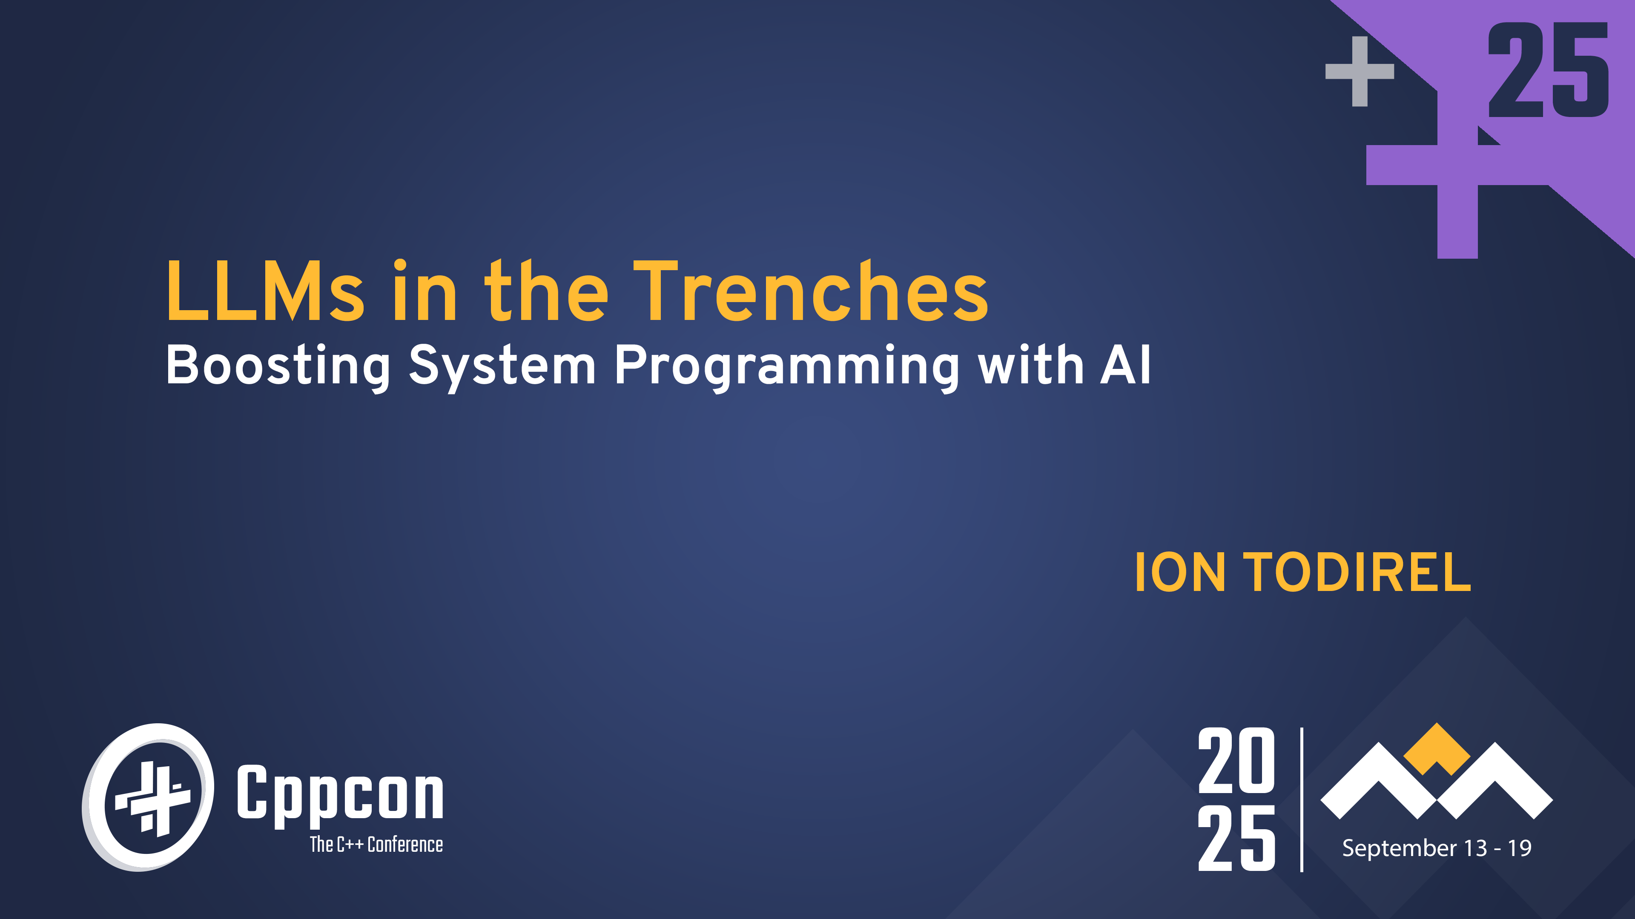

Slide 2
Agenda
Intro
A real-world project with real-world tasks
Solving various real-world tasks with AI
Task
Goals
Solution
Successes and Opportunities
Lessons learned
Conclusion
Notes:
Code completions… useful…

Slide 3
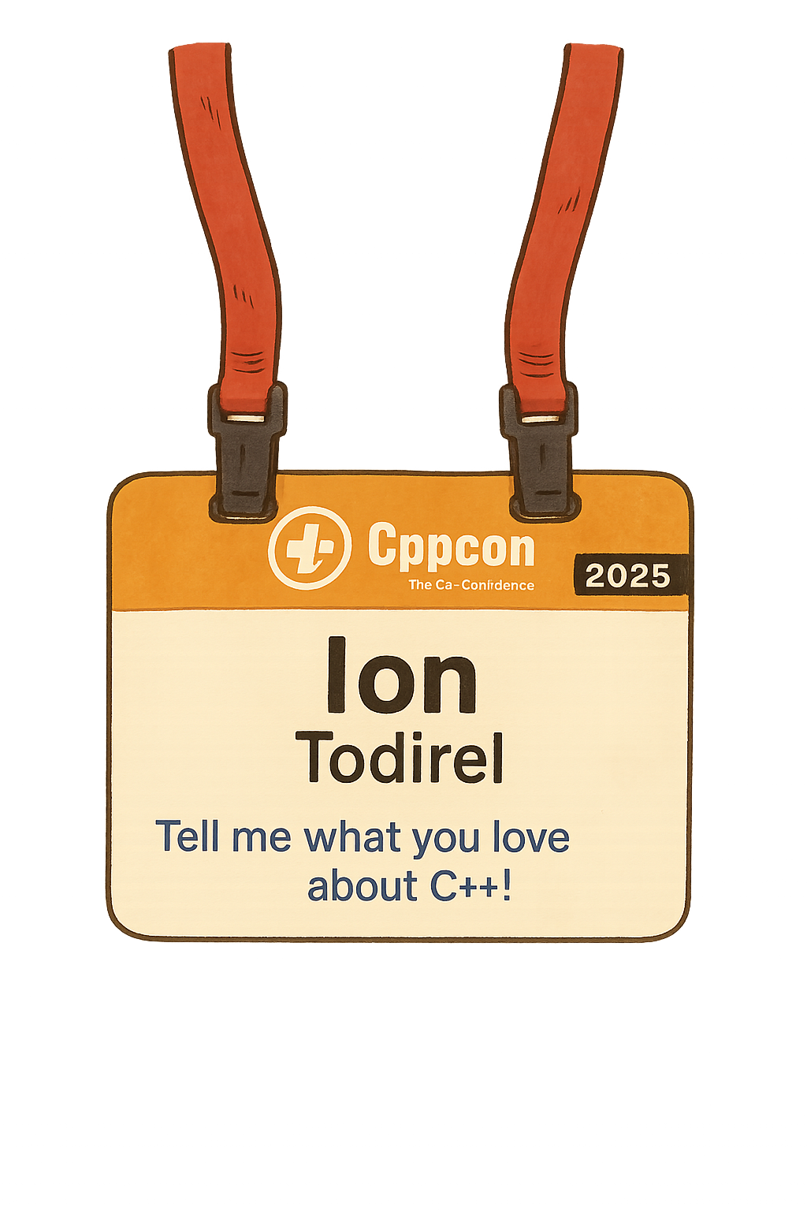
Intro
Engineering Manager at Microsoft
Part of the C++ group: MSVC and C++ Development Experience
C++ is my favorite programming language
My first C++ conference was “Going Native”
Tinkering with SW and EE
Embedded development, sound, power electronics
I am a ham: SW and HW fusion
I got my FCC license in 2022
APRS is my favorite digital mode

Slide 4





Microsoft @ CppCon
Monday, Sept 15 | Tuesday, Sept 16 | Wed, Sept 17 | Thursday, Sept 18 | Friday, Sept 19
Building Secure Applications: A Practical End-to-End Approach | What’s New for Visual Studio Code: CMake Improvements and GitHub Copilot Agents | LLMs in the Trenches: Boosting System Programming with AI | MSVC C++ Dynamic Debugging: How We Enabled Full Debuggability of Optimized Code | Reflection-based JSON in C++ at Gigabytes per Second
Chandranath Bhattacharyya & Bharat Kumar 16:45 – 17:45 | Alexandra Kemper 09:00 – 10:00 | Ion Todirel 14:00 – 15:00 | Eric Brumer 14:00 – 14:30 | Daniel Lemire & Francisco Geiman Thiesen 09:00 – 10:00
 | What’s new in Visual Studio for C++ Developers in 2025 | C++ Performance Tips: Cutting Down on Unnecessary Objects | It’s Dangerous to Go Alone: A Game Developer Tutorial | Duck-Tape Chronicles: Rust/C++ Interop
 | Augustin Popa & David Li 14:00 – 15:00 | Kathleen Baker & Prithvi Okade 15:15 – 16:15 | Michael Price 16:45 – 17:45 | Victor Ciura 13:30 – 14:30
 | Back to Basics: Code Review | Connecting C++ Tools to AI Agents Using the Model Context Protocol | Take our survey, win prizes aka.ms/cppcon/llms
 | Chandranath Bhattacharyya & Kathleen Baker 14:00 – 15:00 | Ben McMorran 15:50 – 16:20
 |  | Welcome to v1.0 of the meta::[[verse]]!
 |  | Inbal Levi 16:45 – 17:45

Slide 5
Audience questions
How many ham radio operators in the room?
How many of you are using AI tools today?
How many of you are building AI tools?
Raise you hand if yes 🤚
Keep your hand down if no 🚫

Slide 6
Project and goals

Slide 7
Repeater and tracker
Data modem
Interface with repeater and tracker
Repeater
Extend network range
Tracker
Position tracking with accurate track representation
Off-grid: no grid, no internet, no infrastructure
Ham radio: VHF 2m, HF 30m & 40m
Miniaturized design: 50mm x 35mm x 10mm
Handheld and battery operated
About 0.3W power consumption
Notes:
We’re going to talk about ham radio… context

Slide 8
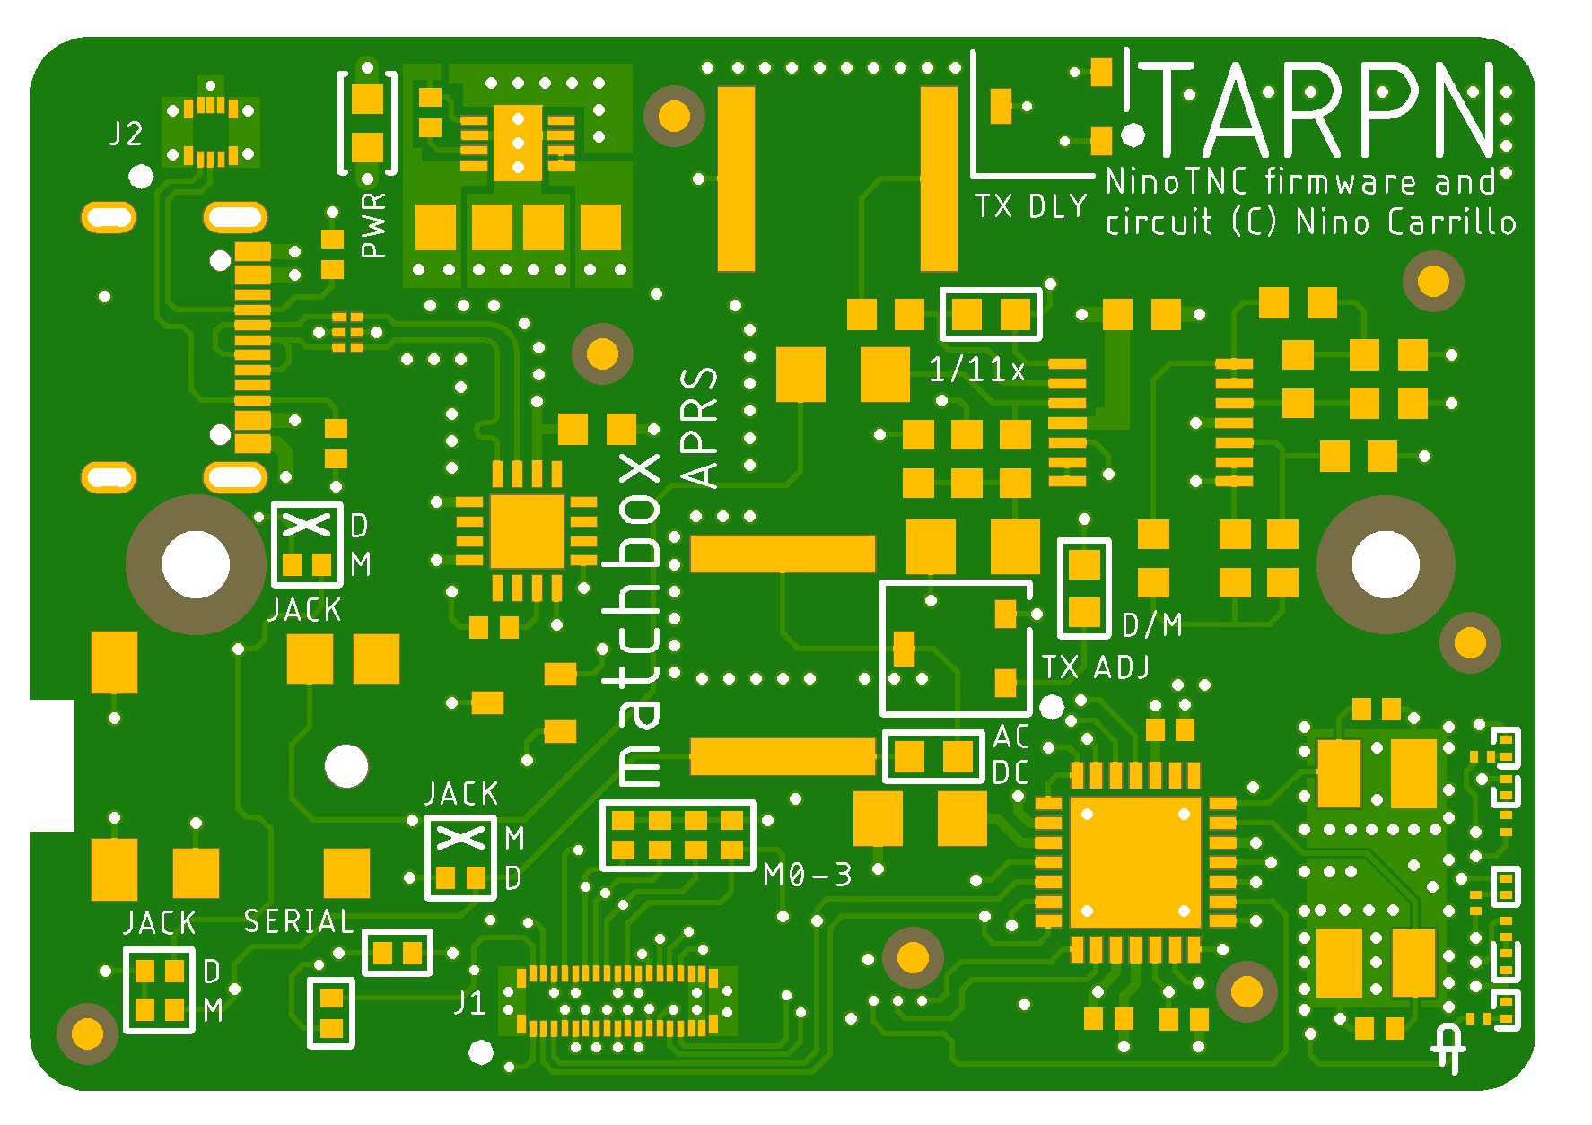
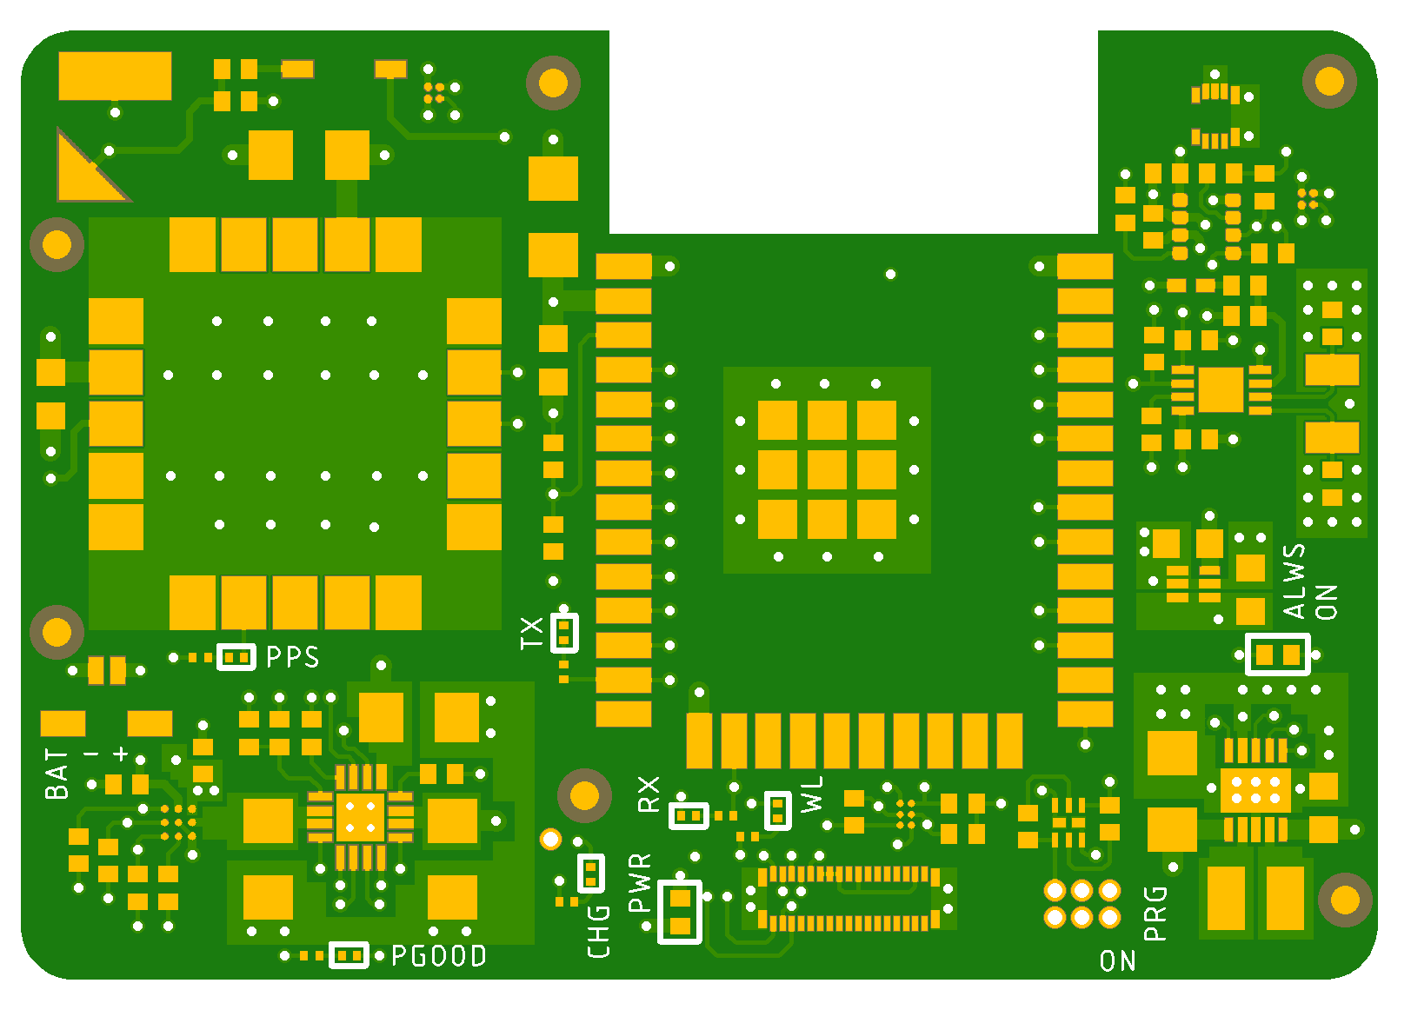
Repeater and tracker
Mainboard: data modem
MCU with DSP, AFE, LDO
USB serial interface
Daughterboard: repeater and tracker
MCU with BT/BLE/Wi-Fi
GNSS receiver
Environment sensor: temp/humidity/pressure
Fuel gauge
Battery charger and power path
Buck-boost and LDO
RTC
Push button controller
Fig.1 - Mainboard PCB render
Mainboard firmware and schematics is based on Nino TNC design (C) Nino Carrillo.
Mainboard and daughterboard design and PCB layout (C) Ion Todirel.
Fig. 2 - Daughterboard PCB render

Slide 9
Mainboard hardware
UART1
UART2
DSPIC33EP256GP502
dsPIC33 MCU
USB UART
LDO
3.3V
MCP2221A
ADPL42005
ADC, PWM
Analog FE Amp & buffer, LPF
MCP6004
Flexible interconnect 2
USB_VBUS, +5V, USB CC1 & CC2
USB-C connector
+5V, D+, D-, CC1, CC2
3.5mm TRRS Jack
RXA, TXA, PTT
Flexible interconnect 1
UART1, UART2, USB_VBUS, +3.3V, TESTTX, DCD, RXT

Slide 10
Daughterboard hardware
MAX16150
CR1025
Push-button
controller
Battery
SOFT POWER-OFF
ESP32-WROOM-32E
ESP32 MCU
TLV70033v
BQ24075
RTC
LDO
3.3V
Buck-boost
2.1-5.5V to 5V
Battery charger
1.5A, power path
I2C
MCP7940N
ADP2503
UART3
I2C
Fuel Guage U and I sampling
Hot-start battery
GNSS receiver
Environment
Sensor
BQ27427
ML414H
M8Q
BME280
Li-Po battery 3.7V 6Wh
Flexible interconnect 1
UART1, UART2, USB_VBUS, +3.3V, TESTTX, DCD, RXT
Flexible interconnect 2
USB_VBUS, +5V, USB CC1 & CC2

Slide 11
Repeater and tracker software
Tracker
Repeater
Use GPS data and decide when to send a packet
Tracker
Packet router. Transform input packets and ready their routing into the network: insert router address, decrement hop count
n-N router
Packet encoder
explicit router
Encoding data into packets
Low level free functions for
encoding data into packet components
Encoding routines
Repeater
Dedupe handling and filtering
Low level framing interfacing with the modem
Frame encoder
Frame decoder
Convert frames into plain text packets
RTC
Environment sensor
Hardware
GNSS receiver
Modem mainboard
Notes:
Highlight tracket and repeater… or border!!!! Software…

Slide 12
Tasks

Slide 13

Tasks
GPIO planning
GPIO programming
Making C++ libraries embedded friendly
Runtime throughput
Memory allocations
Support UTF8 in an API designed for ASCII
GPS and Tracker simulator
Finding USB serial ports

Slide 14
Legend

Slide 15




Legend
Through the talk we will use these icons
AI generated icons for this presentation
Goals
AI solution
Lessons Successes & Opportunities
Task
Solution

Slide 16
AI Tools

Slide 17
AI tools
Web Chat Interfaces, ex: Chat GPT, Claude
Chat interfaces with development context, ex: Copilot
Integrated AI features: on the fly docs, explain error, completions
Chat in agent mode
Async Agents

Slide 18
GPIO planning

Slide 19
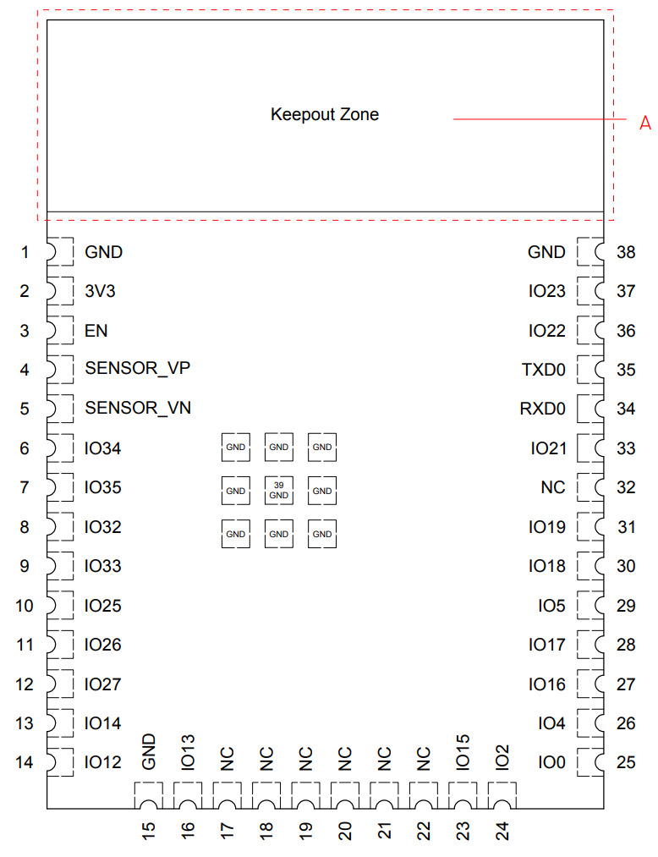
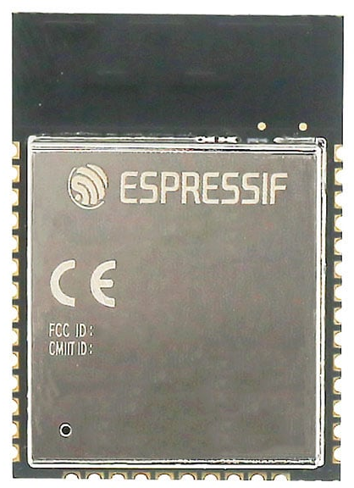
ESP32-WROOM-32E
47 pins
12 pins are GND
7 pins are unconnected
6 pin are strapping pins
These are special purpose and control the boot
They might be autoconfigured to be pulled up
They should not be pulled up or down as could interrupt the boot
EN pin needs an external pull-up resistor during normal operation
Usually, should be avoided
4 pins are GPIO in but not out

Slide 20
GPIO planning goals
4 x GPIO in
Push-button interrupt, Modem: DCD, CRC and packet detection
7 x GPIO out
3 x LEDs, 3 x power on/off control, Modem test TX
3 x UARTs
Modem, USB serial interface, GNSS receiver & flashing
1 x I2C
Fuel gauge, RTC, Environment sensor

Slide 21

GPIO planning
Final AI iteration; friendly name/description generated by humans
Some of the GPIOs remapped due to PCB layout constrains
Pin | GPIO | Function | Name | Description | Subsystem
3 | n/a | swd/reset | SWD | Flashing | Flashing
4 | GPIO36 | gpio/in | PWR INT | Power push button interrupt. Can be used to turn the power off from a button press | Power
5 | GPIO39 | gpio/in | Charge State | Used to detect when the battery is charging | Power
6 | GPIO34 | gpio/in | Modem DCD | Used to detect a binary stream in the demodulator by Modem. Asserted high by the Modem. | Modem
7 | GPIO35 | gpio/in | Modem PKT | Used to detect when a packet arrives from the Modem. Asserted high by the Modem. | Modem
8 | GPIO32 | gpio/out | Modem Test TX | Enables Modem test TX for TX deviation adjustment. | Modem
9 | GPIO33 | gpio/out | GPS Enable | Used to turn the GPS module on. Off = logic low = default, on = logic high. | Power
10 | GPIO25 | uart1/tx | USB Serial | Serial communication from the USB port located on the Modem mainboard. | IO
11 | GPIO26 | uart1/rx | USB Serial | Serial communication from the USB port located on the Modem mainboard. | IO
12 | GPIO27 | gpio/out | PWR KILL | Interfaces with the push button controller to self power off. | Power
13 | GPIO14 | gpio/out | LED TX | Used to indicate TX | IO
16 | GPIO13 | gpio/out | LED RX | Used to indicate RX | IO
25 | GPIO0 | swd/boot | SWD | Flashing | Flashing
27 | GPIO16 | uart2/rx | Modem Serial | Serial communication from the Modem. | Modem
28 | GPIO17 | uart2/tx | Modem Serial | Serial communication from the Modem. | Modem
30 | GPIO18 | gpio/out | LED WL | Used to indicate BT/BLE/WI-FI wireless activity | IO
31 | GPIO19 | gpio/out | Modem Enable | Used to turn the Modem on. Off = logic low = default, on = logic high. | Power
33 | GPIO22 | i2c/sda | I2C | General purpose I2C | IO
34 | GPIO3 | uart0/rx, swd/rx | GPS Serial, SWD | Flashing. Also used for serial communication with the GPS receiver. | Flashing, GPS
35 | GPIO1 | uart0/tx, swd/tx | GPS Serial, SWD | Flashing. Also used for serial communication with the GPS receiver. | Flashing, GPS
36 | GPIO21 | i2c/scl | I2C | General purpose I2C | IO
37 | GPIO23 | n/a | n/a | Unused | n/a
Notes:
What I did I have to do???

Slide 22
GPIO planning
Successes
After few iterations successfully generated a functional plan
Correctly identified EN pin pull-up and capacitor to GND requirements
Correctly identified GPIO in only pins
Identified 3 of the 4 bootstrap pins
Opportunities
Some models only identified SENSOR_VP (GPIO36) as GPIO input only
Avoids using UART0 for functions other than programming
Falsely proposes a plan that requires 4 x UARTs which the ESP32 does not have
Suggested pull-up for GPIO0
Inconsistently and incorrectly identified GPIO14 as a strapping pin
Incorrectly identified 4 pins as connected to the internal flash
Suggested GPIOs that don’t exist
Notes:
Pick a few only? Limit the text these are the contexts I feeded ben: abstraction in general… cases.. System.. Broadly applicable

Slide 23
GPIO planning lessons
Provide the context ahead as much as possible
The more iterations the more requirements for more context later
Don’t limit to one model
What worked best
A prompt with a picture of the pins and GPIOs, pins to avoid, input only pins
Still required few iterations
What required most iterations
A prompt with just the part number and IO requirements
Iteration 1: correction on the pins connected to the flash
Iteration 2: correction on 4 x UART ports
Iteration 3: UART0 can be used for other purposes other than programming
Iteration 4: reminder about the strapping pins
Iteration 5: define explicitly which pins to avoid (lacking memory of bootstrap pins)
Iteration 6: correction on pins that do not exist with picture of the ones that do
Notes:
Conversation….learning… the agents are not just chat vbots

Slide 24
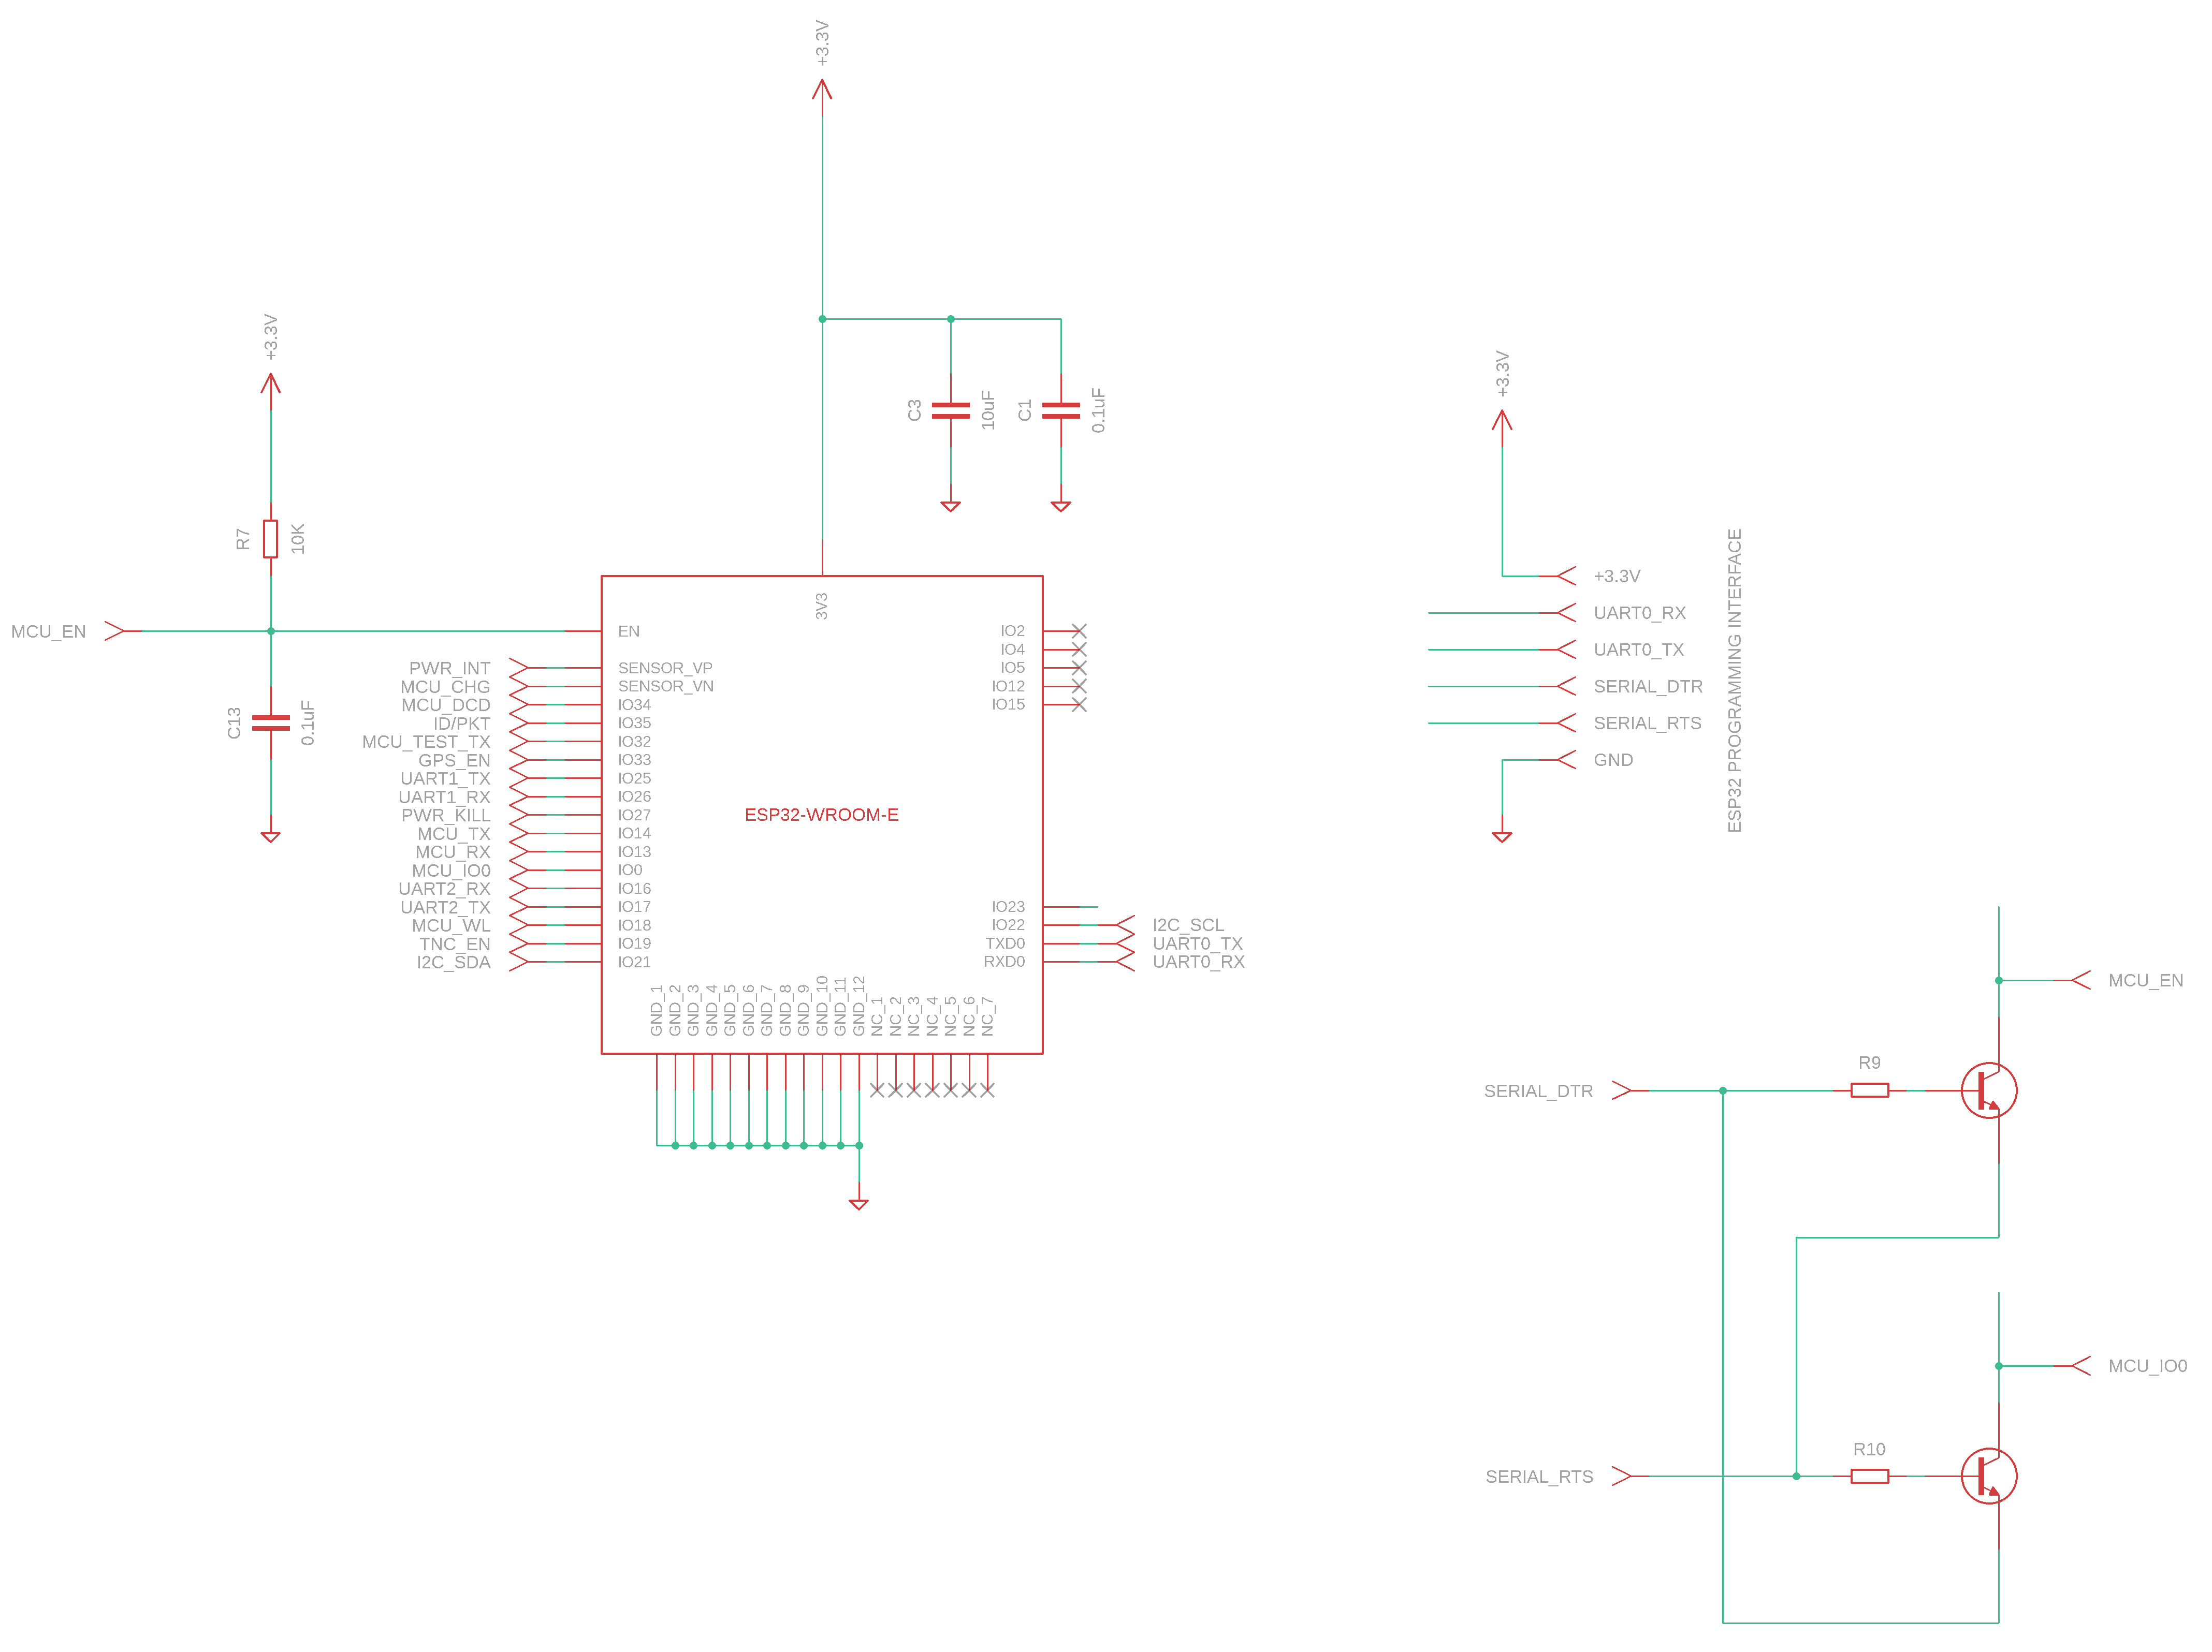
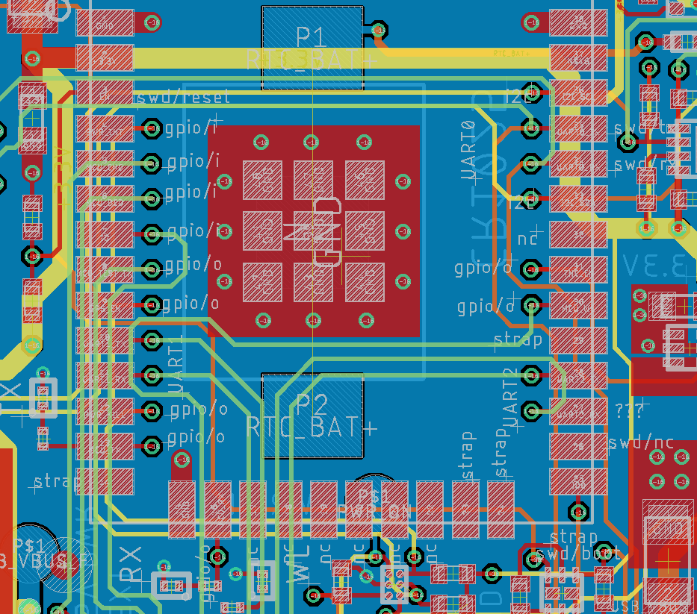
MCU schematic
Fig. 3 - MCU layout (Autodesk Eagle) with documenting labels for the GPIO
Fig. 4 - MCU schematic with programming interface

Slide 25
GPIO programming

Slide 26
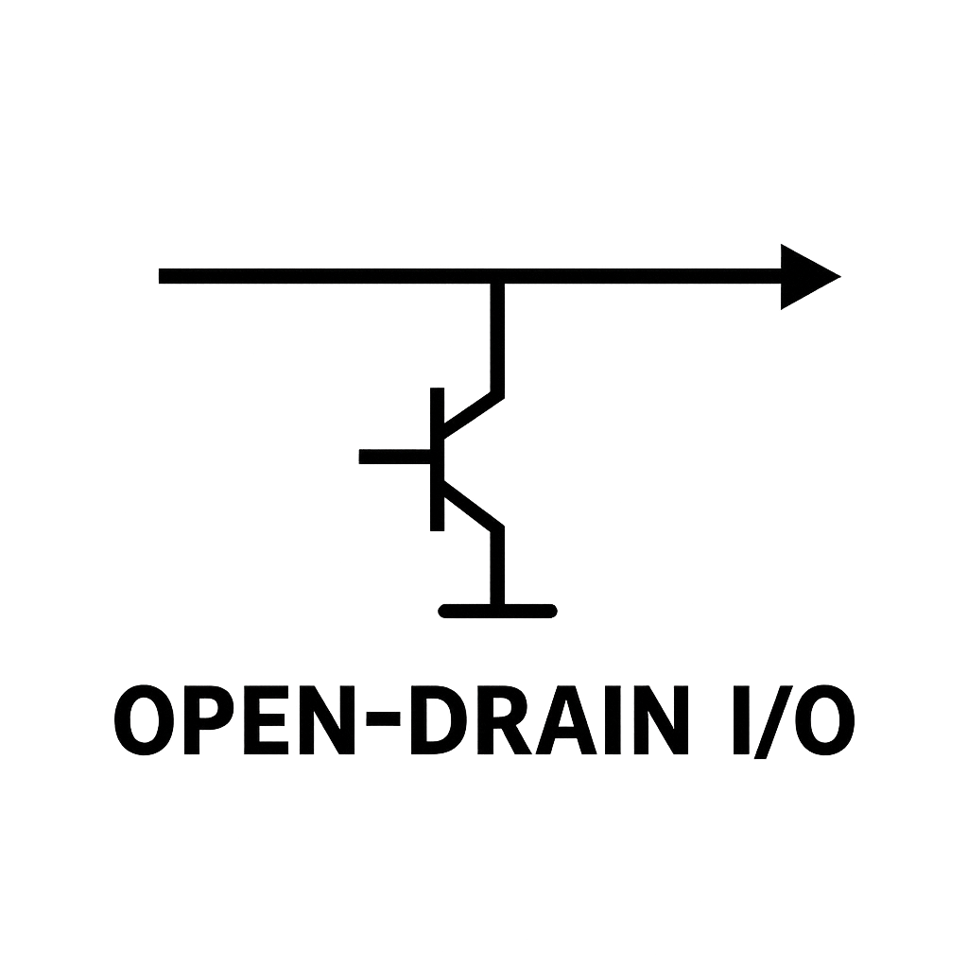
GPIO programming
GPIO plan
Implement initialization logic for GPIO, UART and I2C
Use ESP-IDF
Don’t use deprecated drivers
esp_adc/adc_oneshot.h
driver/i2c_master.h
Interfacing with Open Drain IO

Slide 27
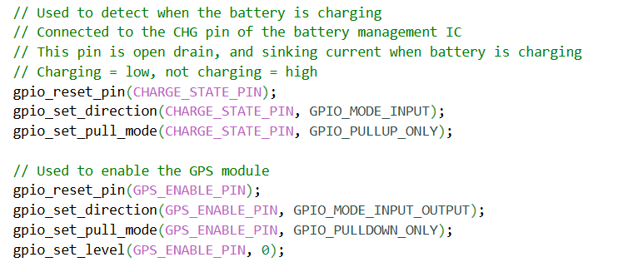
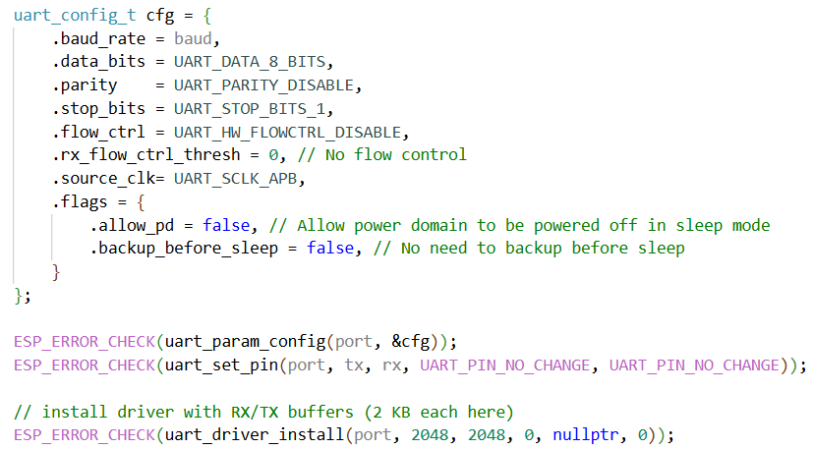
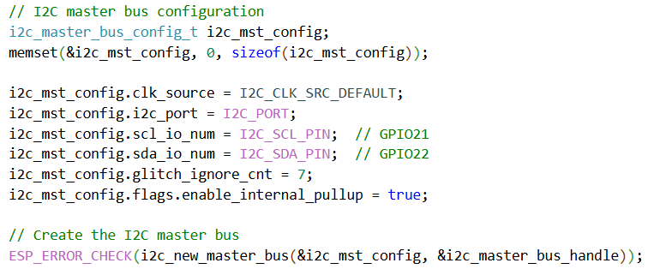
GPIO programming
Final AI revision
Initializing GPIO, UART and I2C
Boilerplate

Slide 28
GPIO programming
Successes
Fast generating the code to get something working
Though the ESP32 platform has great samples, don’t have to leverage it
Correctly suggested the correct configuration for interfacing with open drain IO
Quick iterations to correct all the issues
Opportunities
Without any context it sometimes generated Arduino code
Used gpio_config which is a high level GPIO function
This is fine but I typically prefer the lower-level functions
It left the pins floating and did not set an internal pull-up or pull-down
Did not suggest configuring the output GPIO as GPIO_MODE_INPUT_OUTPUT
Did not fully initialize uart_config_t which generated compile errors
Used deprecated driver/i2c.h instead of the driver/i2c_master.h
The contents displayed in the Web Code Editor did not match the Chat response

Slide 29
GPIO programming lessons
A good example where agentic mode can help
Six iterations on the uart_config_t initialization error
Four iterations to use driver/i2c_master.h with warnings and errors
A use case where the initial code generated by LLMs can be taken and iterated on by hand faster than iterating with LLMs
Sometimes are too slow for fast iterations
The Web Code Editor mode has bugs and should be avoided
I typically instruct the LLMs to not use it, and to provide the code inline
Changes do not match the AI Chat response
Rendering glitches which shows the correct code typed but it is later rewritten to an incorrect version
Notes:
Where is it missing potyential context… point shy away for being too critical….the tools did not show the code making libraries AI friendly… code witter to use AI topols with

Slide 30
Making C++ libraries embedded friendly

Slide 31
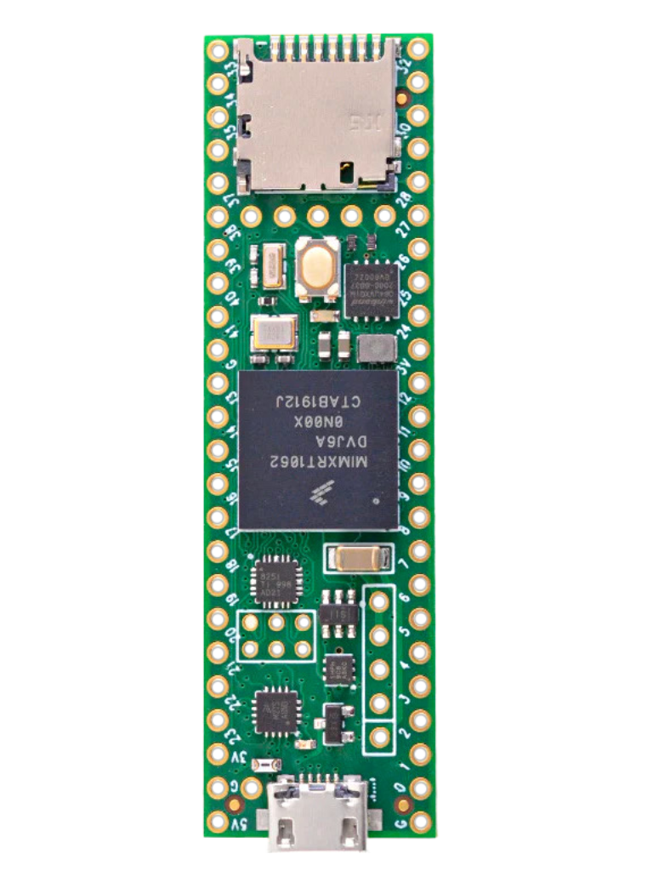
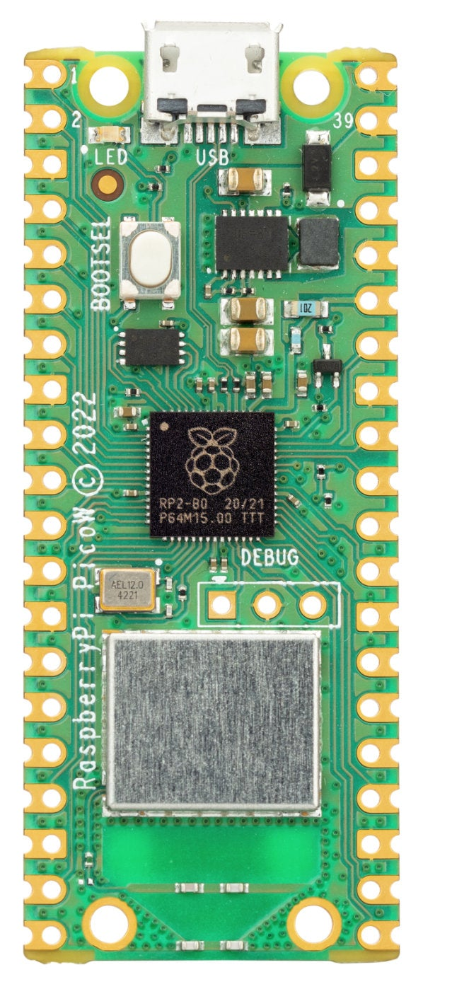
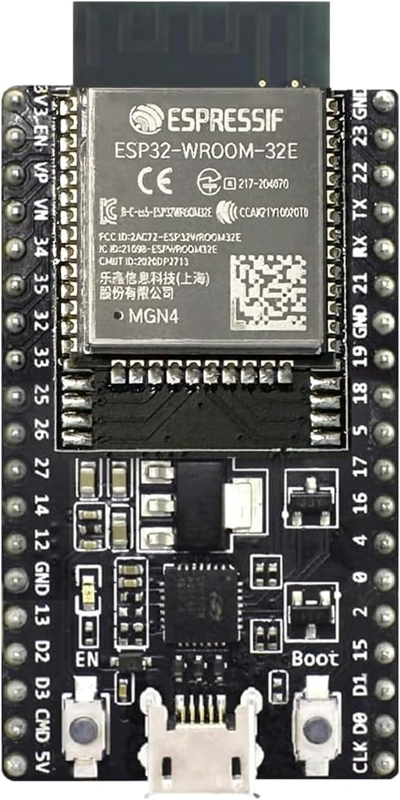
Embedded platforms
Prototype friendly embedded platforms
World class development experience
Raspberry Pi Pico
ESP32
Teensy 4.1

Slide 32
Making C++ libraries embedded friendly
The core libraries support the repeater and tracker
libaprsroute: Core repeater
libaprstrack: Tracker and packet encoding
The libraries were developed on desktop platforms
Header only libraries
Dependency only on a small subset of C++

Slide 33
Embedded friendly goals
Must run on ESP32 and Raspberry Pi Pico
Raspberry Pi Pico: for development purposes only
Nice to have: Arduino, Teensy
Control over heap allocations
OK to allocate at the start but not later
Reasonable throughput, but no hard real-time requirements
Over a ham radio link typically no more than 10-12 packets per minute

Slide 34
Optimization opportunities
Improving enum parsing
Reducing or eliminating copies when comparing addresses
Leveraging the small string optimization
Limiting allocations only to “data out” scenarios
High performance container agnostic APIs
Swappable container types, ex: use stack etl::vector
Swappable string type, ex: use stack etl::string
Polymorphic allocators (PMR) as an input parameter

Slide 35
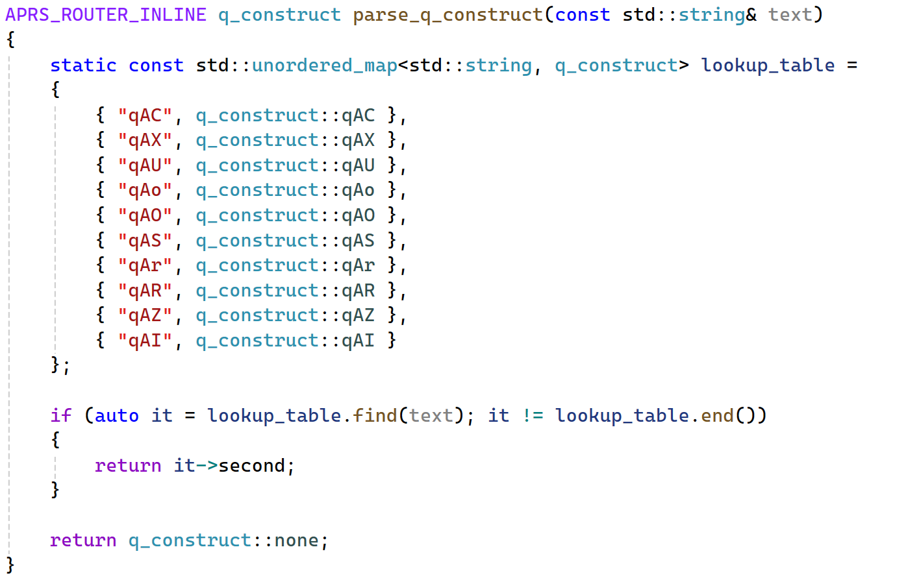
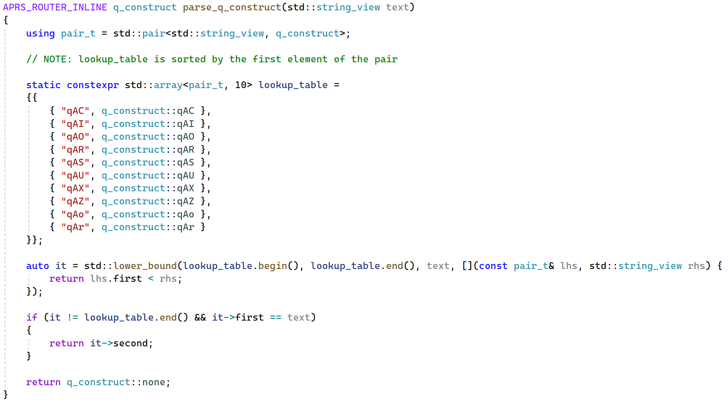
String to enum parsing
First human written version
Allocates on the heap
Memory inefficient
Coupling to std:string which has to be allocated on heap
First AI iteration
No heap usage
Container agnostic (std::string_view) with no coupling to std::string
The enum names are sorted

Slide 36
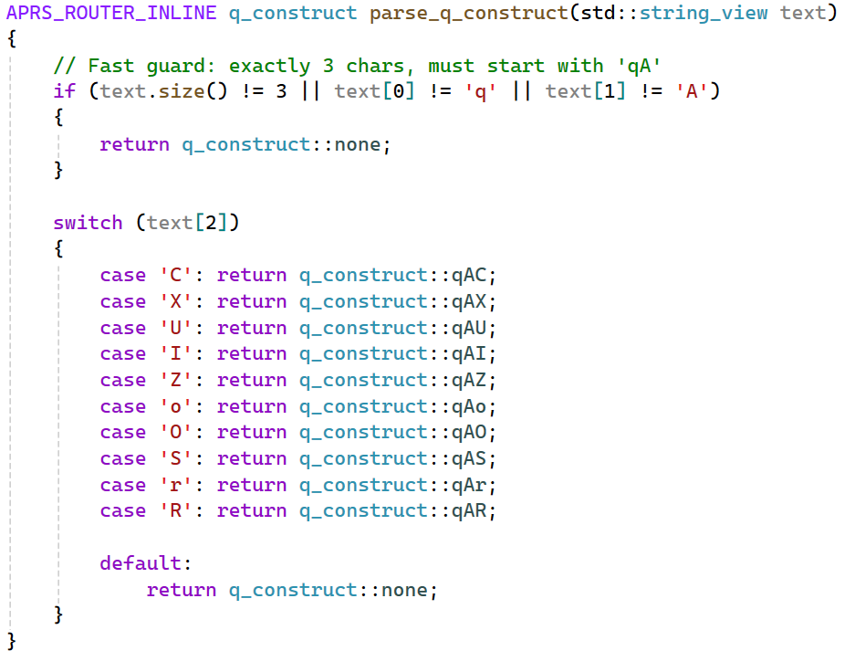
String to enum parsing
First AI iteration
No heap usage
Container agnostic (std::string_view) with no coupling to std::string
The enum names are sorted
Second AI iteration
All enums start with qA
Fast and hand rolled

Slide 37
String to enum parsing
Successes
Immediately recognized optimization opportunities
The human did not immediately recognize all enums starts with “qA”
Provided good and safe solutions with minimum iterations
Little input required
Every iteration better than the last with minimal prompting
Chat in agent mode can ensure the generated code is correct
Opportunities
There is a bias against STL on embedded platforms
const char* recommendation was not great
The hashing suggestions by one model were too unreadable and complex
Notes:
Why stl… context ahead of time sme models….

Slide 38
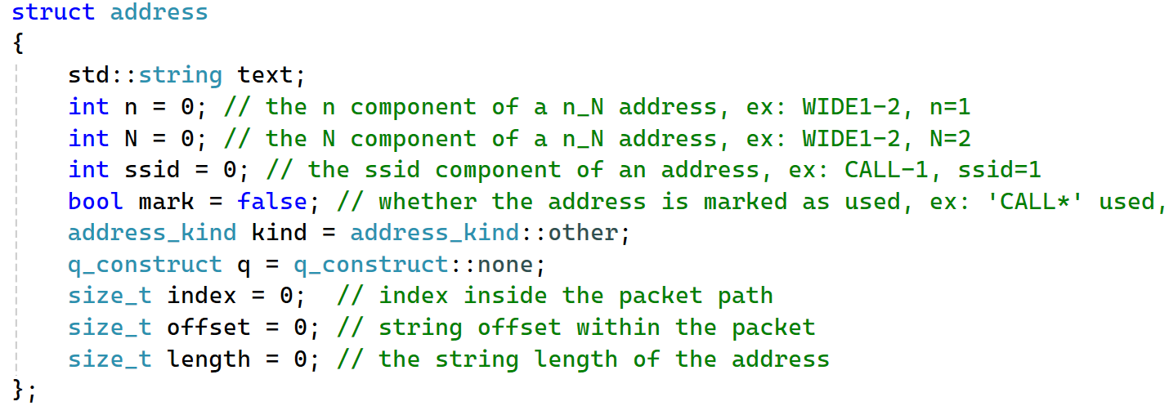
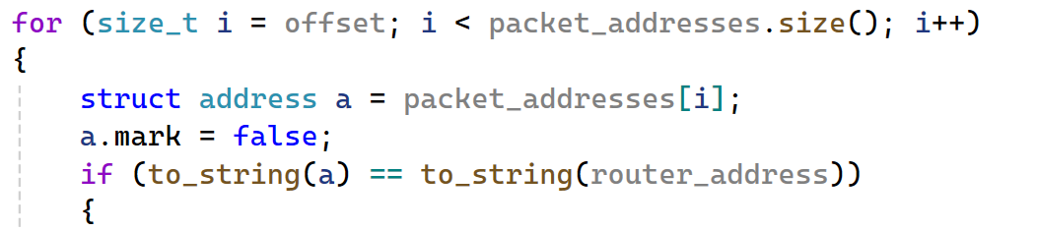
Address comparisons
Address | Address Text | n | - | N | SSID
WIDE1-2 | WIDE | 1 | - | 2 | 0
WIDE1-2 | WIDE1 | 0 | - | 0 | 2
WIDE1 | WIDE | 1 | - | 0 | 0
WIDE1 | WIDE1 | 0 | - | 0 | 0
WIDE1 | WIDE | 1 | - | 0 | 0
WIDE2 | WIDE | 2 | - | 0 | 0
WIDE1-1 | WIDE | 1 | - | 1 | 0
WIDE2-2 | WIDE | 1 | - | 2 | 0
WIDE1-1 | WIDE | 1 | - | 1 | 0
WIDE1-1 | WIDE1 | 0 | - | 0 | 1
WIDE11-1 | WIDE1 | 1 | - | 1 | 0
WIDE11-1 | WIDE11 | 0 | - | 0 | 1
WIDE1 | WIDE | 1 | - | 0 | 0
WIDE1 | WIDE1 | 0 | - | 0 | 0
N0CALL-5 | N0CALL | 0 | - | 0 | 5
One address multiple representations
Address constrains
n must be in the range [1, 7]
N must be in the range [0, 7]
If N > 0, then n > 0 must also hold true
SSID must be in the range [1, 15]
If n > 0, then SSID must be 0
If SSID > 0, then n must be 0
Addresses examples
Address data structure
Address comparison

Slide 39
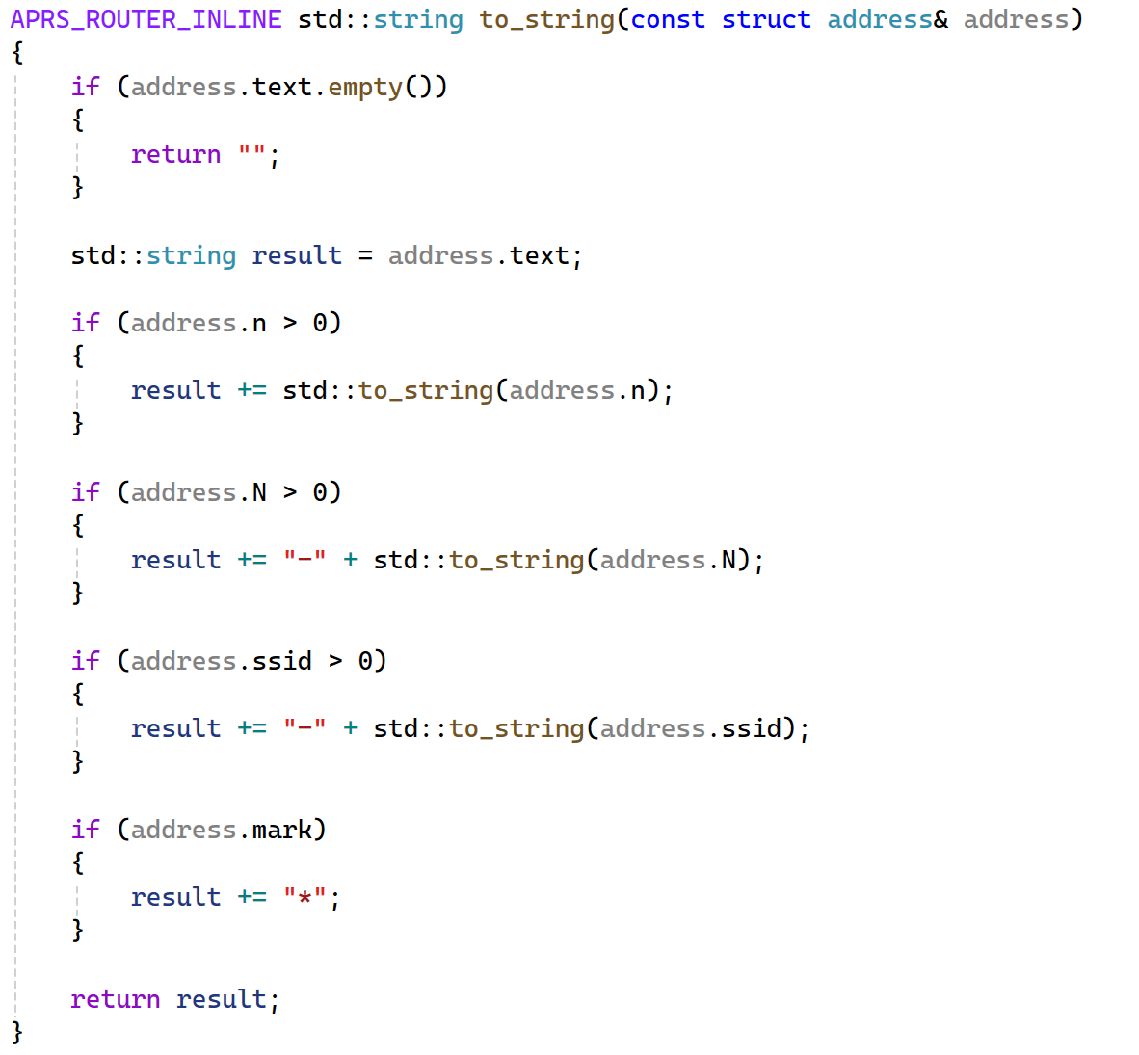
Address comparisons
First human written version
Readable
Appends strings
Uses std::to_string
Notes:
AI can do it, burt lessso.. But it’s up to you if it’s suitable… if it’s fast it’s your repsonsability to reject … that is a

Slide 40
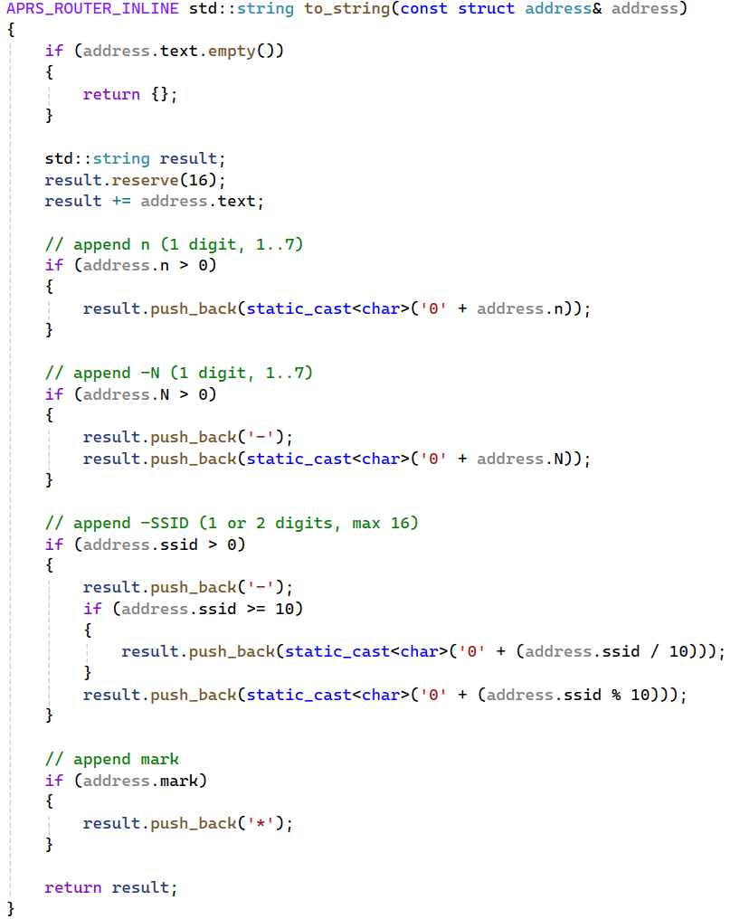
Address comparisons
First AI iteration
SSID not larger than 16
Avoid std::to_string
Avoid string concatenations
Notes:
AI can do it, burt lessso.. But it’s up to you if it’s suitable… if it’s fast it’s your repsonsability to reject … that is a

Slide 41
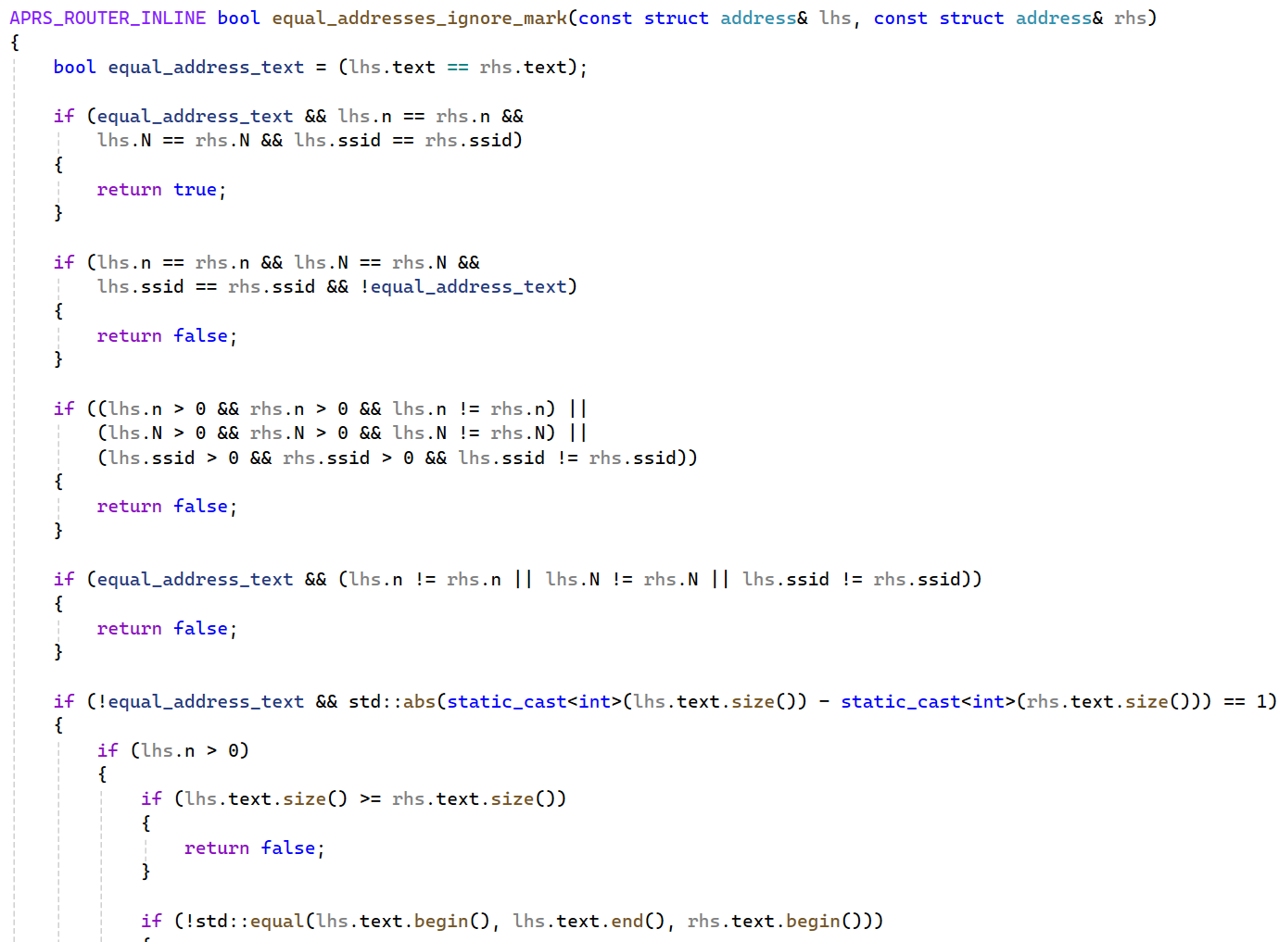
Address comparisons
First human written optimized version
No more address copies
Hand rolled
Address comparison

Slide 42
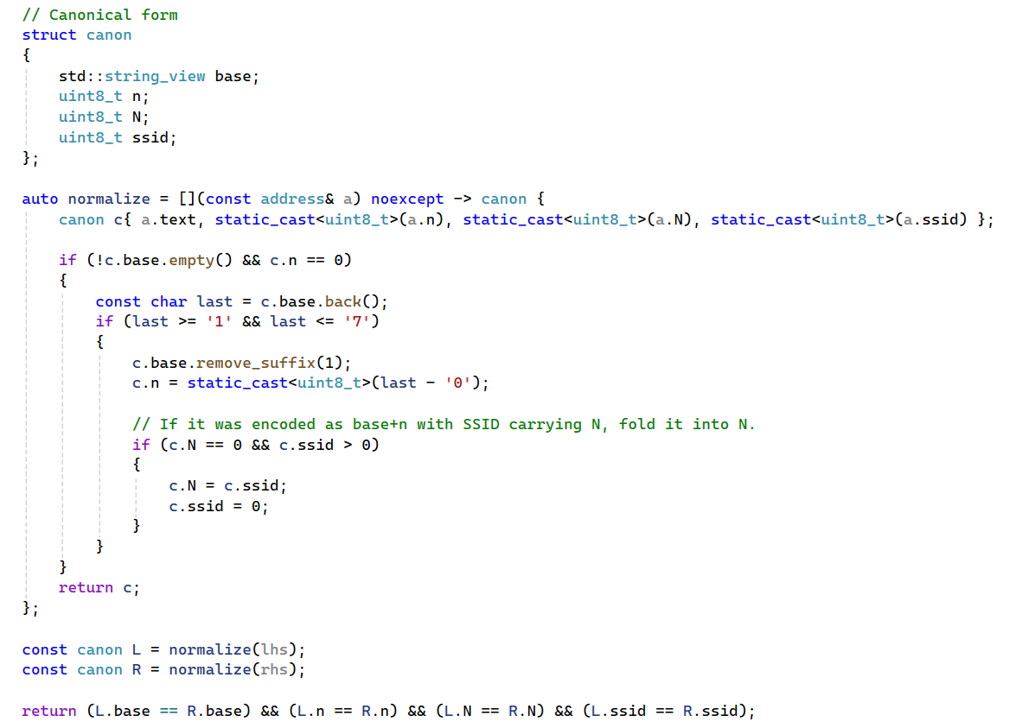
Address comparisons
First AI iteration
Improved readability
Normalization

Slide 43
Address comparisons
Successes
Correct solutions with good readability
Improved readability
Opportunities
Generated code isn’t measured for performance
Generated code isn’t always faster
Unpredictable solutions, same prompt will result in different answers

Slide 44
Lessons
Best programming models aren’t the best for everything
One model suggested hashing with a cost char* interface
3 x iterations with warnings about not using STL on embedded platforms
Another model suggested hand rolled comparison with std::string view
When asked to use <algorithm> it used std::lower_bound with a hand rolled hash
When asked to simplify it used std::lower_bound with a sorted array
The models are non-deterministic
In one go std::lower_bound / sorted array
Notes:
My experience this time… , and you might get different answers for the same question

Slide 45
Lessons
All code paths must be measured, what intuitively seems faster isn’t
Performance tasks are great for agentic tools
Have good code coverage and have the AI tools run your tests
Have a performance test that ensures no perf regressions
The more context and progress you’ve made on a task, the more AI can help
A big functional piece of code that’s well commented works really well
Embedded platforms have come a long way; if you are using the standard library, you might already be there

Slide 46
UTF8 support

Slide 47
UTF8 support
Packets are made of encoded data and text
The message portion of the packet can be UTF8
Support UTF8 in an API designed for ASCII
routing
path
course/speed 3 bytes
altitude 3 bytes
NOCALL-5>T7SVVQ,WIDE1-1,WIDE2-1:`2(al"|[/>"3u}hello world^
from
latitude
longitude
longitude 3 bytes
icon
2 bytes
message
APRS Mic-E packet

Slide 48
UTF8 support
Initial design focused on various string types and transcoding
UTF8 internally
Support common encodings: ASCII, UTF8, UTF16
Take different string types: std::string, std::u8string, std::wstring
Use codecvt to convert between types
Final design doesn’t have to handle transcoding
Core encoding is encoding invariant and uses std::string/std::string_view
The message is accepted as various string types and converted to bytes
Encoded packet is returned as a sequence of bytes

Slide 49
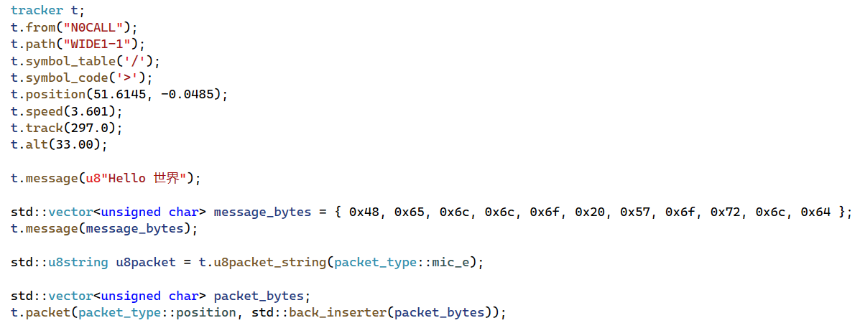
UTF8 support
Various ways to set a message
Various ways to encode a packet

Slide 50
UTF8 support
Successes
Code generated with codecvt was functional
Recognized early codecvt is deprecated in C++17 and removed in C++20
This was a bit of a shock, and I had to double check
Recommended iconv and ICU
Generated functional code for ICU
With only 3 iterations AI can be led to the best solution
Opportunities
Took a few iterations before recognizing codecvt is deprecated
On Windows suggested MultiByteToWideChar/WideCharToMultiByte

Slide 51
GPS and Tracker simulator

Slide 52
GPS and Tracker simulator
During tracker development we need GPS data
It’s not feasible to drive around during development
Visualize and understand dynamic behavior
Parameter tweaking for accurate but efficient track representation
Create tests and find bugs

Slide 53
GPS and Tracker simulator
Render a map
Generate a route from pairs of start lat/lon and end lat/lon
Generate lat/lon/speed track data for a route
Create a GPS simulator running real-time or accelerated
Feed GPS simulator data into the tracker and visualize it on a map

Slide 54
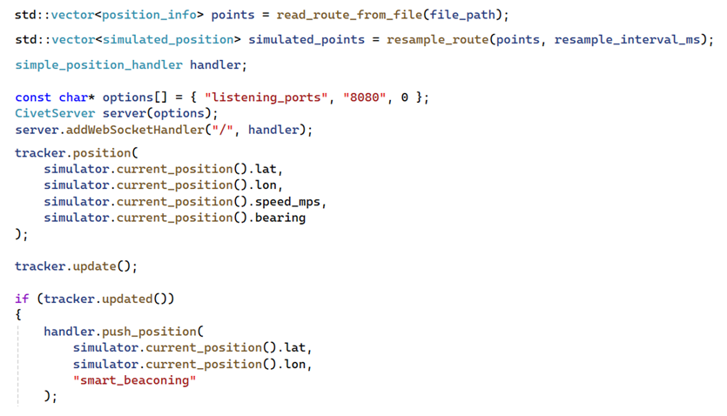
GPS and Tracker simulator
Use OSM and Valhalla to generate static test data
GPS simulator uses interpolation and haversine to playback data
GPS simulator output is fed to the tracker
Tracker renders the data to a HTML/JavaScript client using a WebSocket server

Slide 55
GPS and Tracker simulator
Successes
Local OSM server running in a container
Local Valhalla server running in a container
Python script with two requests to Valhalla: route and trace_attributes
Test data generation
Interpolation function and haversine
Boost ASIO and Civet WebSocket server
Open Layers HTML/JavaScript client
Opportunities
Difficult to complete the GPS simulator design; individual pieces ok
Many iterations required while using 3 LLMs, no model could complete the task
Initial code was not very readable

Slide 56
GPS and Tracker simulator lessons
LLMs are scary good at Python, HTML and JavaScript
Python scripts were complete in the first iteration
Generated code for Open Layers was super easy to iterate on
LLMs aren’t so good at complex design problems requiring solving multiple subproblems
Able to solve each individual sub-problem but not the whole problem
Short memory
20+ iterations each time with no good results
Successful if scoped to smaller sub problems while the human does the design and integration
Generated code readability varies with the task complexity

Slide 57
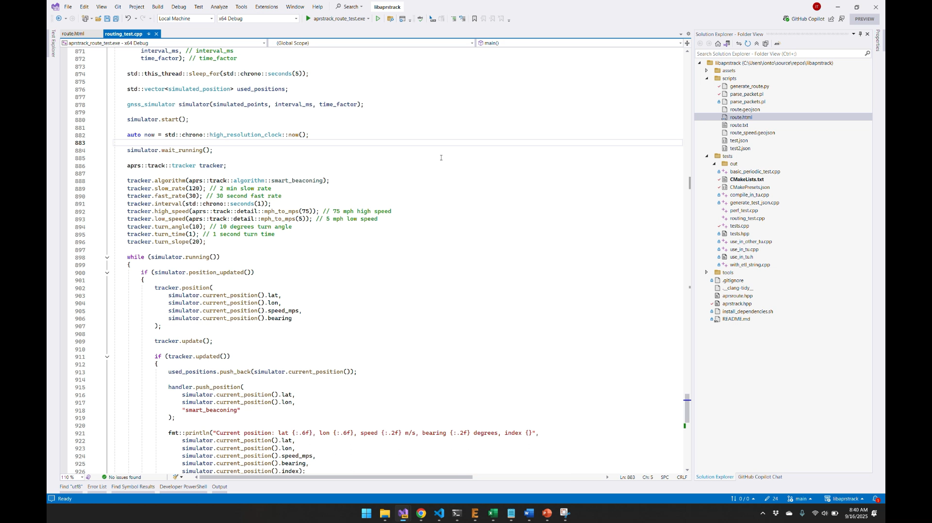
GPS and Tracker simulator

Slide 58
Finding USB serial ports

Slide 59
Finding USB serial ports
The mainboard has a USB serial interface
Programmatically find the mainboard
This is leveraged in testing
Used by a containerized system running the repeater
Linux only solution
Serial ports are not mounted to the same name
udev is great but we don’t want to change the system configuration
Use unique hardware properties to identify each device
Address each mainboard even if 5 are mounted
Some USB serial devices have empty USB descriptors

Slide 60
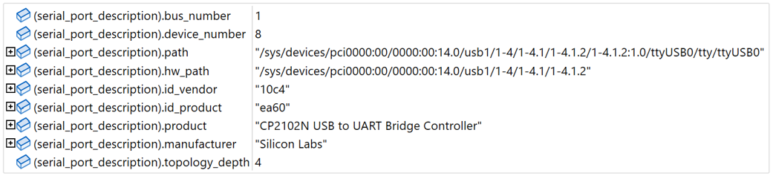
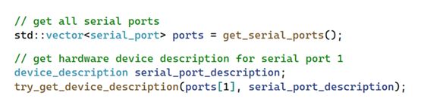
Finding USB serial ports
Enumerate serial ports using udev
Extract various port information like name, serial number, description, udev path etc.
Identify and match information unique to each device, ex: serial number

Slide 61
Finding USB serial ports
Successes
Identified early that udev can be used to find serial ports
Generated code to query udev
udev filter queries were great
JSON serialization
Opportunities
Inconsistent and unreliable udev properties mapping
const char* manufacturer = udev_device_get_sysattr_value(usb_dev, "manufacturer");
const char* product = udev_device_get_sysattr_value(usb_dev, "product");
const char* serial = udev_device_get_sysattr_value(usb_dev, "serial");

Slide 62
Conclusion

Slide 63
Conclusion
LLMs are super useful in prototyping and early design and can increase productivity significantly
LLMs can help with the boiler plate, and we have lots in C++ too
Not every answer have to be perfect and complete to be useful
Some iterations can be long and frustrating
Agents can help and shorten the iteration time
LLMs are pretty good and getting better
A level of understanding and competence is required to apply LLMs effectively
Better prompts will not likely compensate for LLMs limitations

Slide 64
Q&A

Slide 65
Q&A
CR1025 Primary Lithium battery (other side)
Load switch
mezzanine connector
quad
op-amp
Hot start battery
GNSS receiver
mezzanine connector
LDO
MCU
TVS diodes
Load switch
Environment sensor
USB-C
connector
RTC
crystal oscillator
LED (1/6)
LDO
3.5mm TRRS audio jack
5 x LEDs
Buck-boost
USB UART
MCU
crystal oscillator
Battery charger
dual npn transistors
high density
mezzanine connector
Fuel gauge
on interface & programming interface
high density
mezzanine connector
Push-button controller

Slide 66
Appendix

Slide 67
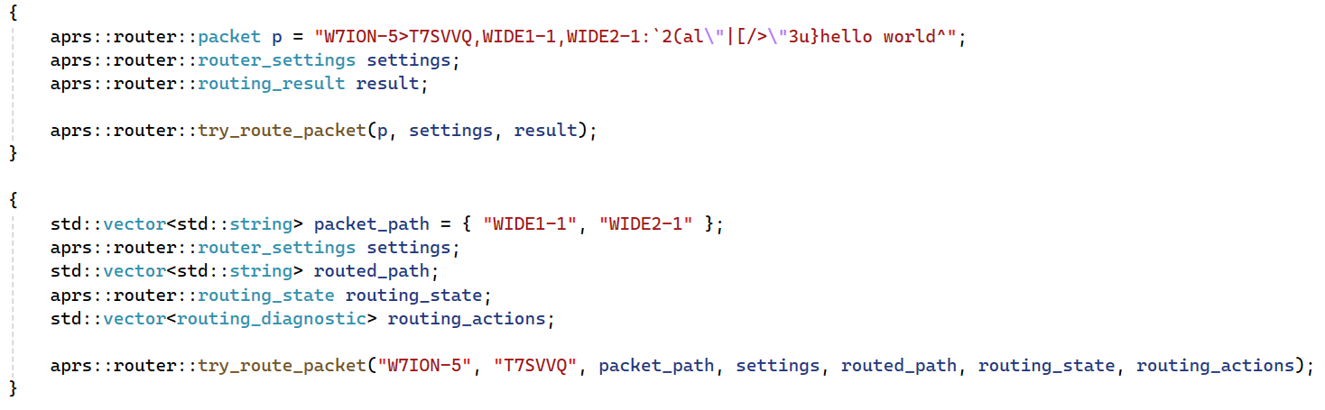
Finer grain control over allocations
Replace packet::from, packet::to with string_view
No dependency on the larger packet type
The results can be pre-allocated
Notes:
Remove non AI slides? Criteria: - is this a problem I solved with an LLM - is there some lesson that I can impart using this example and no other…
- Can you fit an examplaination in the amount of time?

Slide 68
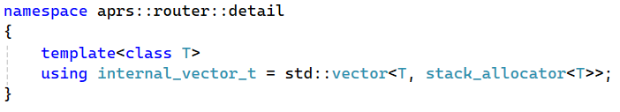
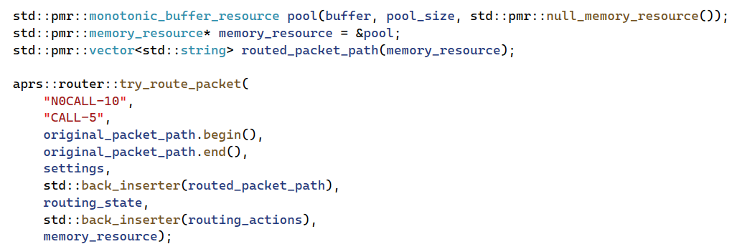
Swappable string and containers
Can use any container type
Can use any string type
Can use PMR

Slide 69
Small String Optimization
libaprsroute processes lots of strings but constrained to 9 bytes
Smaller strings are allocated on the stack
Stored in a small buffer within the container, usually 16 bytes
Not changes are needed for the string interface
With SSO
char data[16] = "string\0";
int length = 6;
Without SSO
char* data = new char[7];
memcpy(data, "string", 6);
data[6] = '\0'; int length = 6;
The examples above are illustrative only

Slide 70
C++ Status on Embedded Platforms
The Arduino platform is not great for C++ development
Artificially limited to C++11
AVR based platforms have no standard library support
ARM based platforms have inconsistent support: 🟨 Arduino Zero, ❌ Arduino Due
Limited or no tooling extensibility
ESP32 and Raspberry Pi Pico have great C++20 support
Pico has out-of-the-box and first class CMake integration in VSCode
ESP-IDF VSCode integration is good but a little bit more esoteric
Teensy support limited to C++17, C++20 support can be hacked in
 | ESP32 | Raspberry Pi Pico | Teensy | Arduino AVR | Arduino ARM
Language Standard | ✅ C++20 | ✅ C++20 | C++17 | C++11 | C++11
Standard Library | ✅ newlibc | ✅ newlibc | ✅ newlibc | ❌ none | 🟨 limited
Notes:
appendix

Slide 71
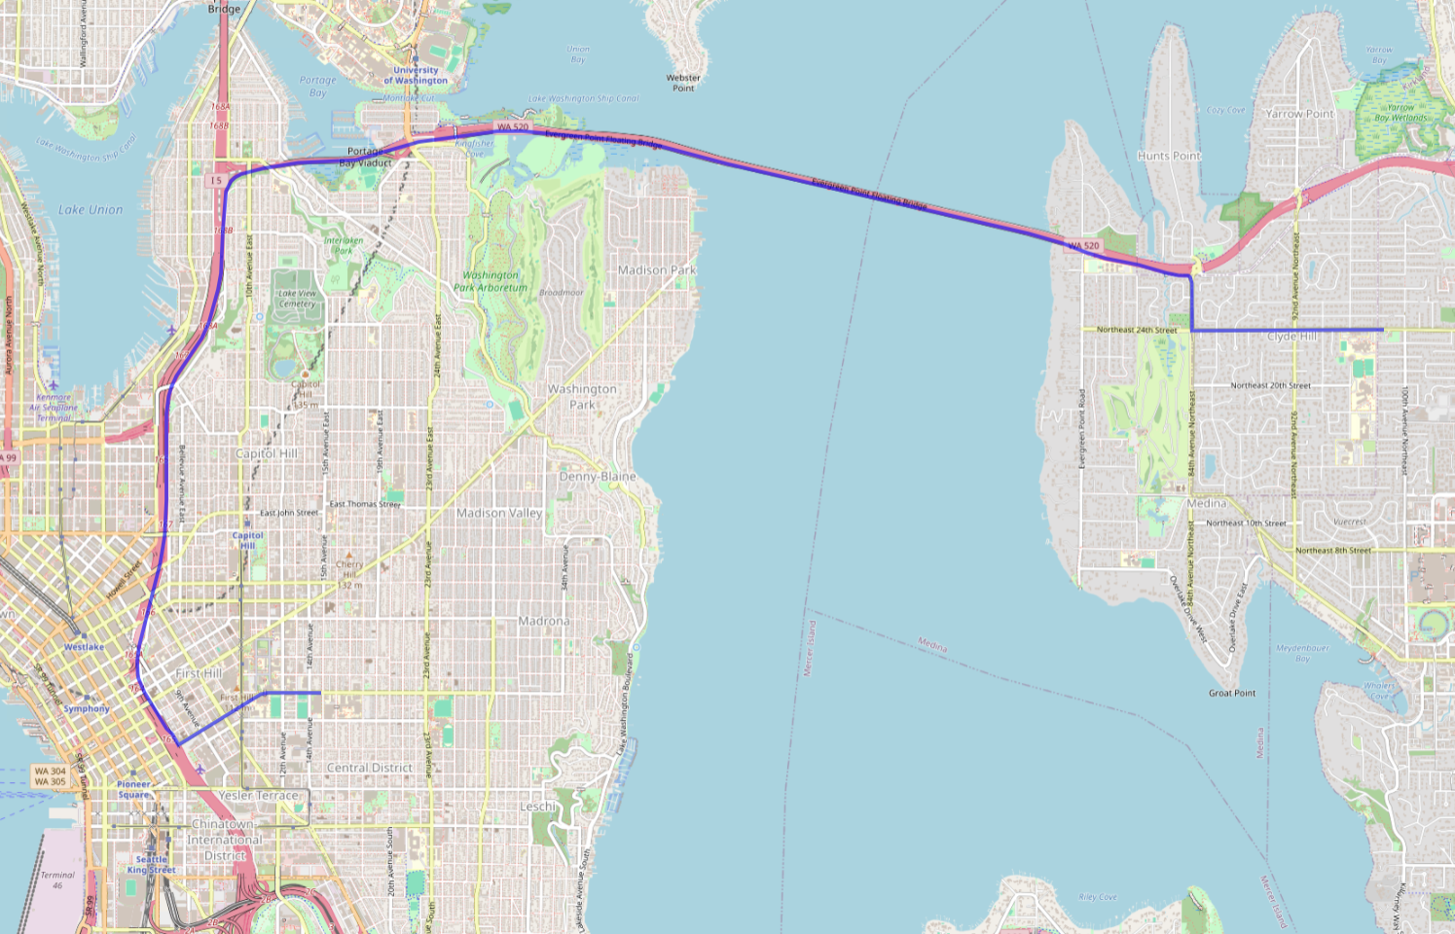
Position tracking: “Route” as lat/lon/speed
Using Docker compose
Docker Image: ghcr.io/gis-ops/docker-valhalla/valhalla:latest
Requests
curl -X POST "http://192.168.1.190:8002/route" -H "Content-Type: application/json" -d '{
"locations": [
{"lat": 47.6080, "lon": -122.3130},
{"lat": 47.6320, "lon": -122.2091}
],
"costing": "auto",
"directions_options": {"units": "miles"}
}’
curl -X POST "http://192.168.1.190:8002/trace_attributes" -H "Content-Type: application/json" -d '{
"shape": [
{"lat": 47.6319580078, "lon": -122.2173919678},
{"lat": 47.6319694519, "lon": -122.2151260376}
],
"costing": "auto",
"shape_match": "map_snap",
"directions_options": {"units": "miles"}
}'
Route rendering

Slide 72
Enumerating audio devices
#include <alsa/asoundlib.h>
int card_id = -1; while (true)
{
snd_card_next(&card_id);
snd_ctl_t* ctl_handle = nullptr;
snd_ctl_open(&ctl_handle, fmt::format("hw:{}", card_id).c_str(), 0);
while (true)
{
int device_id = -1;
snd_ctl_pcm_next_device(ctl_handle, &device_id);
snd_pcm_info_t* pcm_info = nullptr;
snd_pcm_info_set_device(pcm_info, device_id);
snd_pcm_info_set_subdevice(pcm_info, 0);
snd_pcm_info_set_stream(pcm_info, SND_PCM_STREAM_CAPTURE);
snd_ctl_pcm_info(ctl_handle, pcm_info);
char* name = nullptr;
snd_card_get_name(card_id, &name);
char* long_name = nullptr;
snd_card_get_longname(card_id, &long_name);
fmt::format("hw:{},{}", device.card_id, device.device_id);
}
}
hw:0
USB PnP Sound Device
C-Media Electronics Inc. USB PnP Sound Device
hw:0,1
Notes:
this is what is like using ALSA, it’s a C API
SND_PCM_STREAM_CAPTURE

Slide 73
Volume Controls
#include <alsa/asoundlib.h>
snd_mixer_t* handle;
snd_mixer_selem_id_t* sid;
snd_mixer_open(&handle, 0);
snd_mixer_attach(handle, ("hw:" + std::to_string(device.card_id)).c_str()));
snd_mixer_selem_register(handle, nullptr, nullptr);
snd_mixer_load(handle);
snd_mixer_selem_id_malloc(&sid);
snd_mixer_selem_id_set_index(sid, 0);
snd_mixer_elem_t* elem = nullptr;
for (elem = snd_mixer_first_elem(handle); elem; elem = snd_mixer_elem_next(elem))
{
snd_mixer_selem_get_id(elem, sid);
audio_device_volume_control volume_control;
const char* control_name = snd_mixer_selem_get_name(elem);
for (int channel_id = 0; channel_id <= SND_MIXER_SCHN_REAR_CENTER; channel_id++)
{
const char* channel_name = snd_mixer_selem_channel_name(channel_id);
long min = 0, max = 100, value = 0;
snd_mixer_selem_get_playback_volume_range(elem, &min, &max);
snd_mixer_selem_get_playback_volume(elem, channel_id, &value);
}
}
hw:0
Speaker
Front Left
Notes:
As far as I know this isn’t possible to do in Windows.

Slide 74
Enumerating Serial Ports
#include <libudev.h>
udev* udev = udev_new();
udev_enumerate_add_match_subsystem(enumerate, "tty");
udev_enumerate_scan_devices(enumerate);
udev_list_entry* devices = udev_enumerate_get_list_entry(enumerate);
udev_list_entry* dev_list_entry;
udev_list_entry_foreach(dev_list_entry, devices)
{
const char* path = udev_list_entry_get_name(dev_list_entry);
udev_device* dev = udev_device_new_from_syspath(udev, path);
const char* devnode = udev_device_get_devnode(dev);
udev_device* usb_dev = udev_device_get_parent_with_subsystem_devtype(dev, "usb", "usb_device");
const char* manufacturer = udev_device_get_sysattr_value(usb_dev, "manufacturer");
const char* product = udev_device_get_sysattr_value(usb_dev, "product");
const char* serial = udev_device_get_sysattr_value(usb_dev, "serial"); }
/dev/ttyUSB0
f6a69ba44567ec119b112342ef680de7
Silicon Labs

Slide 75
Mapping: Devices to udev
Serial port to device description
#include <libudev.h>
udev* udev = udev_new();
udev_enumerate* enumerate = udev_enumerate_new(udev);
udev_enumerate_add_match_subsystem(enumerate, "tty");
udev_enumerate_add_match_property(enumerate, "DEVNAME", p.name.c_str());
udev_enumerate_scan_devices(enumerate);
udev_list_entry* devices = udev_enumerate_get_list_entry(enumerate);
udev_device* device = udev_device_new_from_syspath(udev, udev_list_entry_get_name(devices));
udev_device* usb_device = udev_device_get_parent_with_subsystem_devtype(device, "usb", "usb_device");
const char* syspath = udev_device_get_syspath(device);
const char* usb_syspath = udev_device_get_syspath(usb_device);
/dev/ttyUSB0
filter
/sys/devices/pci0000:00/0000:00:14.0/usb1/1-4/1-4.1/1-4.1.2/1-4.1.2:1.0/ttyUSB0/tty/ttyUSB0
Sound card to device description
card0
udev_enumerate_add_match_subsystem(enumerate, "sound");
udev_enumerate_add_match_sysname(enumerate, fmt::format("card{}", d.card_id).c_str());

Slide 76
Mapping: Serial Port to Sound Card
Serial port device description to sound card mapping
/sys/devices/pci0000:00/0000:00:14.0/usb1/1-4/1-4.1/1-4.1.2/1-4.1.2:1.0/ttyUSB0/tty/ttyUSB0
#include <libudev.h>
udev* udev = udev_new();
udev_device* dev = udev_device_new_from_syspath(udev, desc.path.c_str());
udev_device* usb_dev = udev_device_get_parent_with_subsystem_devtype(dev, "usb", "usb_device");
udev_device* parent_usb_dev = udev_device_get_parent_with_subsystem_devtype(usb_dev, "usb", "usb_device");
udev_enumerate* enumerate = udev_enumerate_new(udev);
udev_enumerate_add_match_parent(enumerate, parent_usb_dev);
udev_enumerate_add_match_subsystem(enumerate, "sound");
udev_enumerate_add_match_sysname(enumerate, "card*");
udev_list_entry* sibling_list_entry = nullptr;
udev_list_entry* devices = udev_enumerate_get_list_entry(enumerate);
udev_list_entry_foreach(sibling_list_entry, devices)
{
const char* path = udev_list_entry_get_name(sibling_list_entry);
udev_device* sibling_dev = udev_device_new_from_syspath(udev, path);
udev_device* sibling_usb_device=
udev_device_get_parent_with_subsystem_devtype(device, "usb", "usb_device");
}
/sys/devices/pci0000:00/0000:00:14.0/usb1/1-4/1-4.1/1-4.1.1/1-4.1.1:1.0/sound/card2

Slide 77
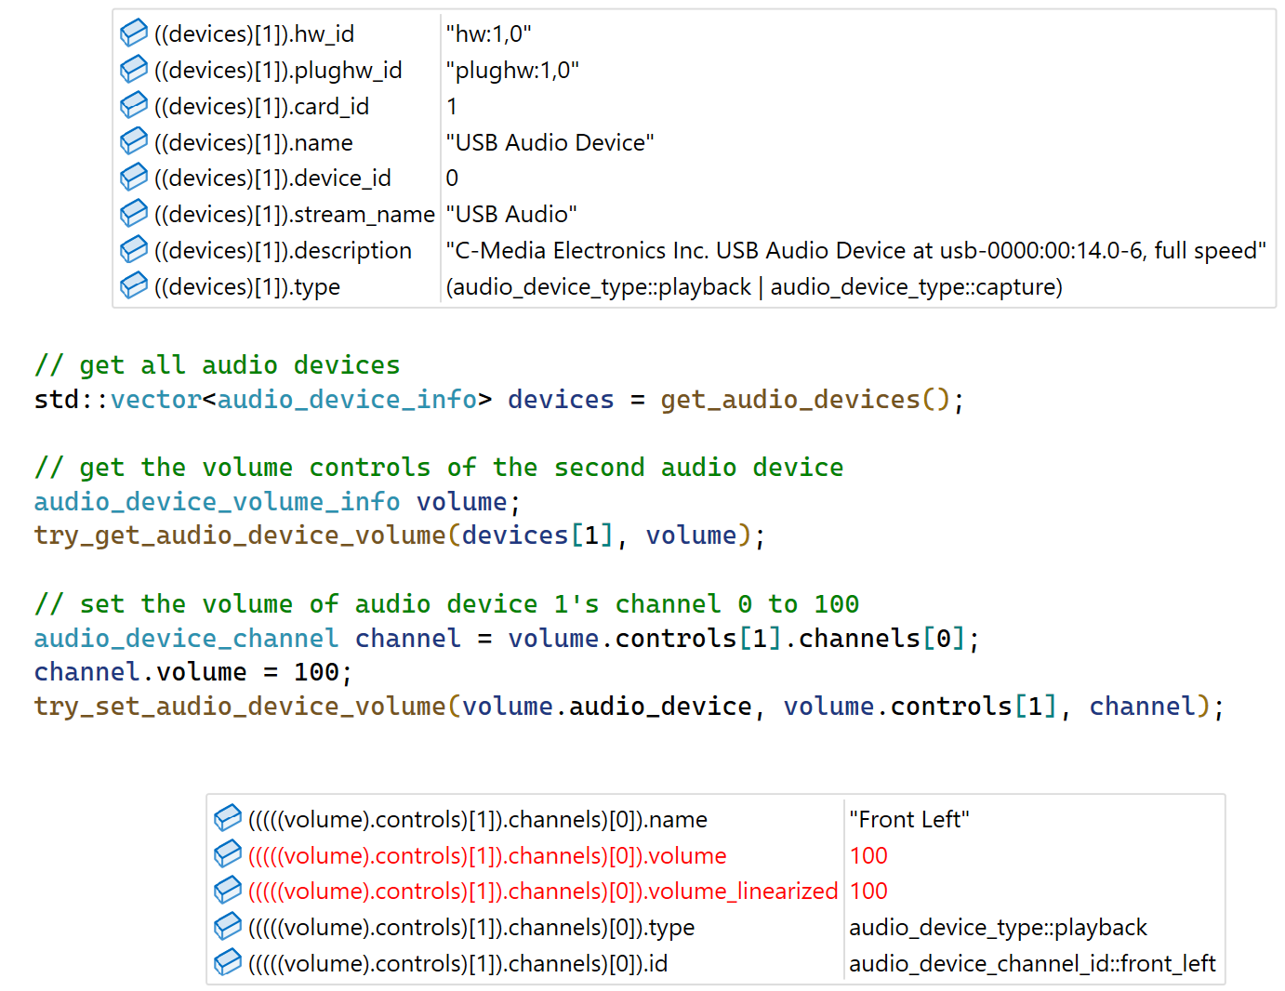
Audio API Design
struct audio_device_info
{
std::string hw_id;
std::string plughw_id;
int card_id = -1;
int device_id = -1;
std::string name;
std::string stream_name;
std::string description;
audio_device_type type = audio_device_type::uknown;
};
struct audio_device_channel
{
std::string name;
int volume = 0;
int volume_linearized = 0;
audio_device_type type = audio_device_type::uknown;
audio_device_channel_id id = audio_device_channel_id::none;
};
struct audio_device_volume_control
{
std::string name;
std::vector<audio_device_channel> channels;
};
struct audio_device_volume_info
{
audio_device_info audio_device;
std::vector<audio_device_volume_control> controls;
};
API Usage Example Runtime Information
std::vector<audio_device_info> get_audio_devices();
bool try_get_audio_device_volume(const audio_device_info& device, audio_device_volume& volume);
bool try_set_audio_device_volume(const audio_device_info& device,
const audio_device_volume_control& control, const audio_device_channel& channel)

Slide 78
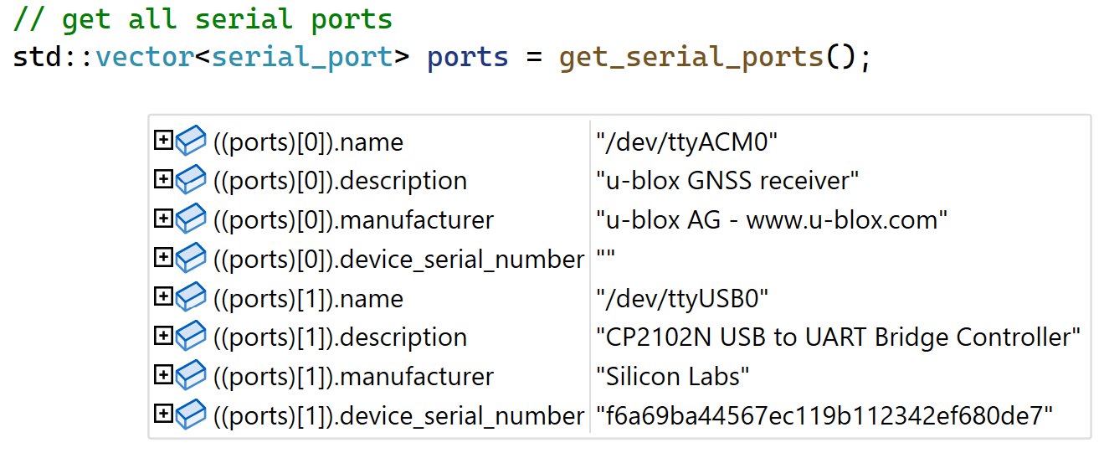
Serial Ports API Design
struct serial_port
{
std::string name;
std::string description;
std::string manufacturer;
std::string device_serial_number;
};
std::vector<serial_port> get_serial_ports();
API Usage Example
Runtime Information

Slide 79
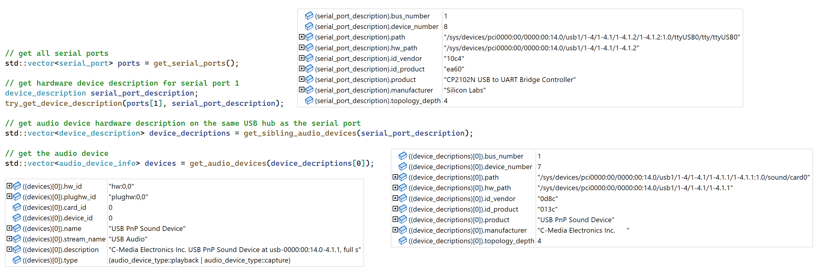
Mapping API Design
struct device_description
{
int bus_number = -1;
int device_number = -1;
std::string path;
std::string hw_path;
std::string id_vendor;
std::string id_product;
std::string product;
std::string manufacturer;
int topology_depth = -1;
};
bool try_get_device_description(const audio_device_info& d, device_description& device);
bool try_get_device_description(const serial_port& d, device_description& device);
std::vector<audio_device_info> get_audio_devices(const device_description& desc);
bool try_get_serial_port(const device_description& desc, serial_port& p);
std::vector<device_description> get_sibling_audio_devices(const device_description& desc);
std::vector<device_description> get_sibling_serial_ports(const device_description& desc);
API Usage Example Runtime Information

Slide 80
References
https://github.com/iontodirel/find_devices
https://github.com/iontodirel/matchbox_aprs
https://github.com/iontodirel/libaprs
https://github.com/iontodirel/libaprsroute
https://github.com/iontodirel/libaprstrack

